Slide 1

Insights from Social Media Analytics Nanke Williams October 2023

Slide 2
Outline
Executive Summary
Introduction
Methodology
Results
Conclusion
Appendix

Slide 3

Executive Summary
Summary of methodologies
Data Collection
Data Wrangling
Exploratory Data Analysis with Visualization
Interactive Visual Analytics with Tableau
Statistical Analysis
Summary of all results
Findings from Exploratory Data Analysis
Findings from Interactive Analytics
Findings from Statistical Analytics

Slide 4

Introduction
Project background and context
Playhouse Communication is one of Nigeria's leading digital marketing agencies. They combine design and media planning with cutting-edge tech solutions to reimagine what marketing is all about.
The goal of the project is to decode a treasure trove of social media data for one of their high-profile clients and transform it into game-changing insights.
Project Deliverables
We will determine responses to Key Questions derived during Exploratory Analysis.
We will use Statistical Analysis to test whether the hypothesis raised from charts are significant and these relationships truly exist.
Make recommendations based on insights generated from Exploratory and Statistical Analysis.

Slide 5
Section 1 Methodology

Slide 6
Methodology
Executive Summary
Data preparation methodology.
Perform exploratory data analysis (EDA) with visualization
Perform interactive visual analytics using Tableau
Perform statistical analysis

Slide 7
Data Preparation
Collect Dataset
Clean Dataset
Prepare Dataset for Analysis
The dataset was collected from four social media websites: Facebook, Instagram, Twitter & LinkedIn.
Each social media dataset had 147 unique features which allowed for merging them into a single dataset.
The dataset was cleaned and analyzed in a jupyter notebook environment using Python.
Please see the jupyter notebook for more information.

Slide 8
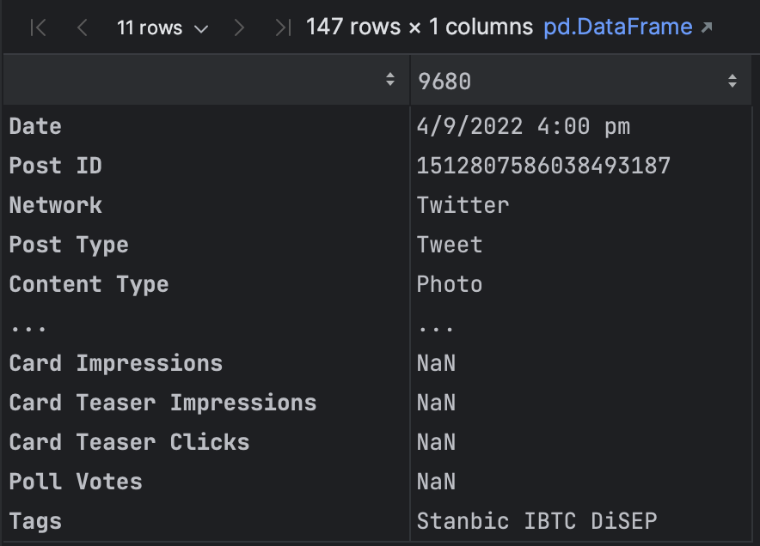
Data Preparation – Sample Record
Each record had a feature stating:
The social media network they originated from.
The date and time the Post was sent.
The type of content they were, the text of the Post.
The name of the sender of the post.
General and specific social media metrics collected by the network.
Please see the jupyter notebook for more information.

Slide 9
Data Preparation – Data Cleaning Strategy
Empty rows & duplicate rows were removed.
The date feature was cleaned and converted to datetime type.
New columns for hashtags, post word counts, character counts, and sentiments were added.
Each column was converted to its appropriate datatype
Datatypes to be changed
More than 30 columns were removed because they contained no data.
The data in ‘Potential Reach’ which represented ‘Reach’ data from Twitter was moved to the ‘Reach’ column.
Impute missing values for numeric and categorical features.
Set Date as Index.
Please see the jupyter notebook for more information.

Slide 10
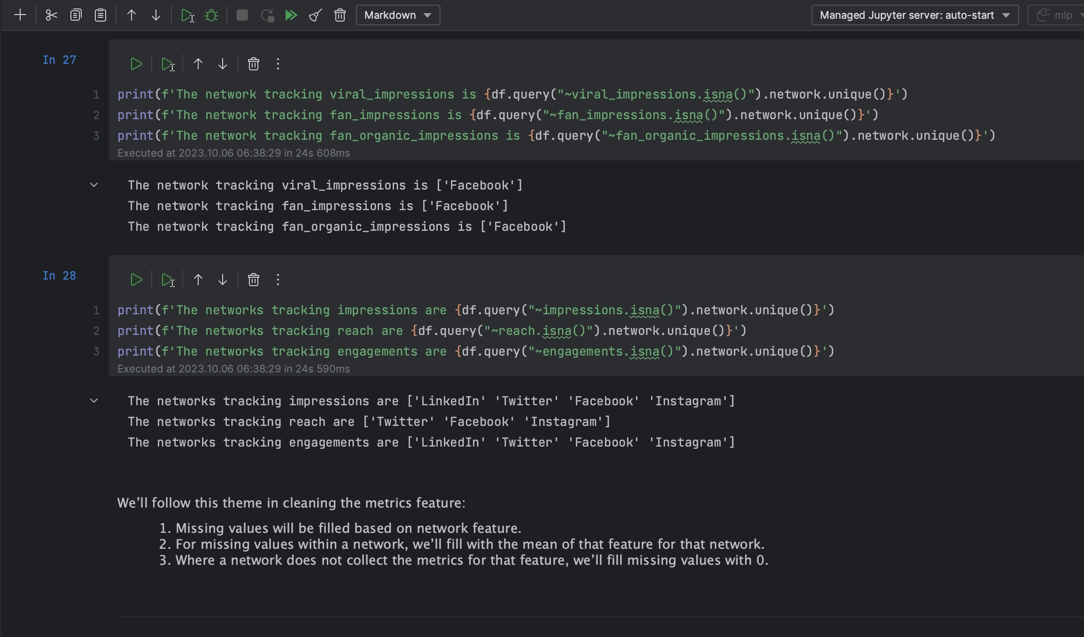
Data Preparation – Data Imputation Strategy
There are certain metrics that are network-specific, i.e., tracked and collected by only certain networks.
Our data imputation strategy for missing values is:
Where the metric is collected by a social media network, missing values will be imputed using the average of that metric filtered by the relevant social network.
Where the metric is not collected by a social network, missing values will be imputed using zero, representing that the metric is not collected by the social media network.
For categorical or text-based features, missing values were imputed using text stating that no value was provided for the record.
Please see the jupyter notebook for more information.

Slide 11
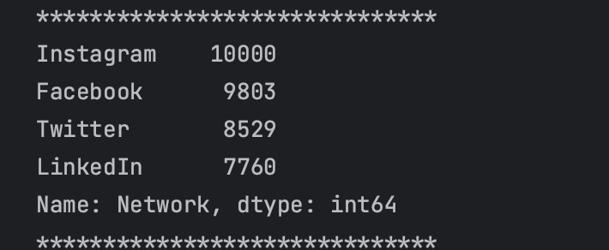
Data Preparation – Summary of the Dataset
The dataset has 36,092 rows.
There are 3 categorical features, 4 text-based features and 105 numeric features.
There are 4 distinct networks, 7 distinct content types and 12 distinct senders in the dataset.
The dataset has date records spanning the 11-year period ranging from 2013 to 2023
Please see the jupyter notebook for more information.

Slide 12
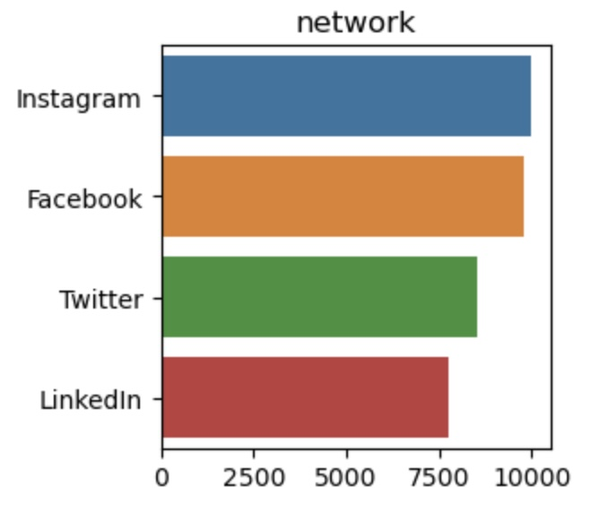
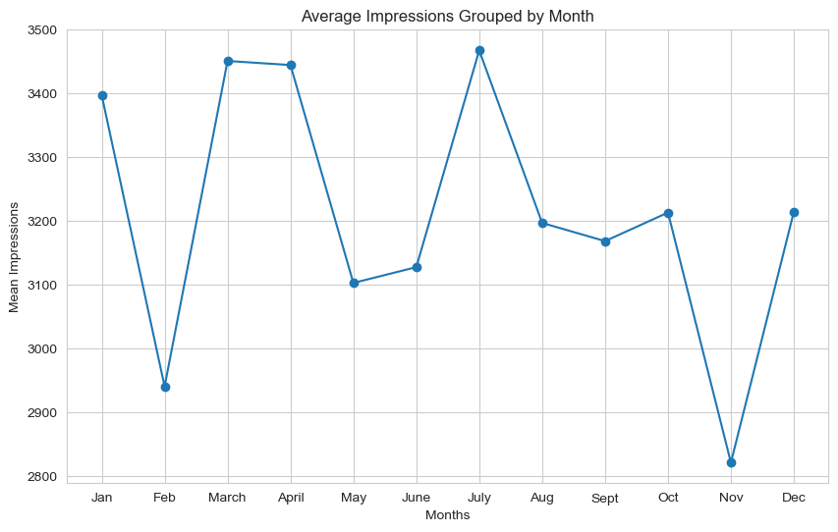
Exploratory Data Analysis with Visualization
We visualized the relationship between a few variables in the dataset to determine:
If variables are correlated.
How categorical variables are distributed over numeric metrics.
What trends over time are evident in variables
We visualized variable distributions to make assumptions for statistical analyses.
We used word clouds to visualize hashtags to understand what posts are talking about.
Please see the jupyter notebook for more information.
Example - Bar Chart Spread of Social Media Networks
Example – Line Chart of Monthly Impressions

Slide 13
Exploratory Data Analysis with Visualization
We conducted exploratory data analysis to determine:
What posts are talking about.
What kind of posts are popular.
What are the most engaging types of posts.
Which platform yields the highest engagement for the client.
What are the peak times for user engagement.
What are the noticeable trends over time (e.g., increasing likes, decreasing shares).
What are the sentiments of posts and how does it affect engagement.
Please see the jupyter notebook for more information.

Slide 14
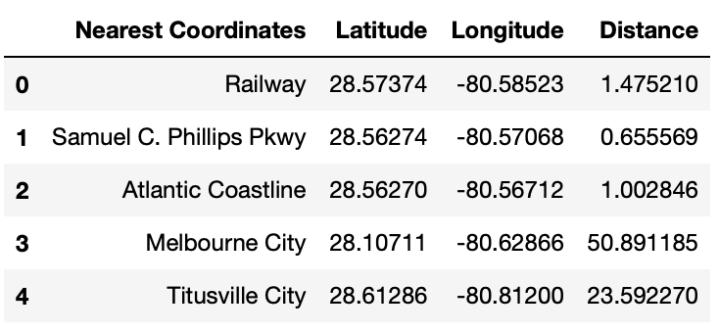
Interactive Dashboard on Tableau
Using an Interactive Folium Map:
We marked all launch sites, and added map objects such as markers, circles, lines to mark the success or failure of launches for each site.
Using the color-labeled marker clusters, we identified which launch sites have relatively high success rate.
We calculated the distances between a launch site and some nearby coordinates.
GitHub URL – Interactive Visual Analytics with Folium Map Notebook

Slide 15
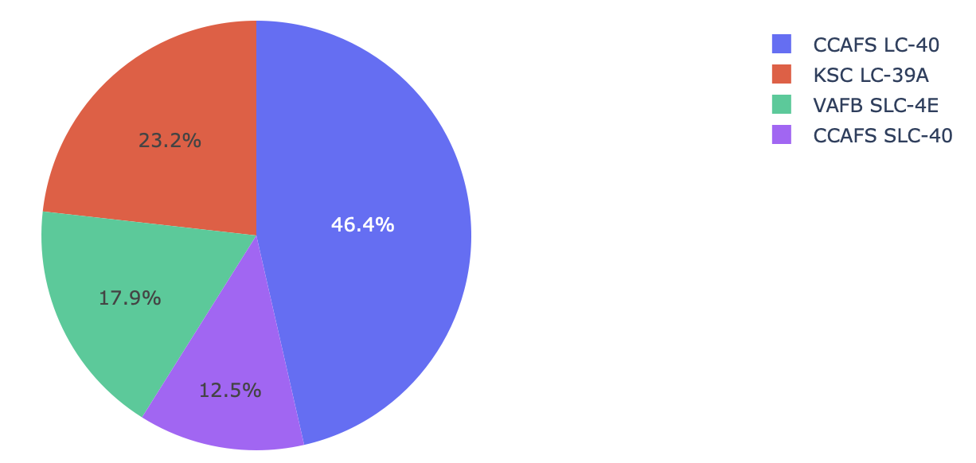
Build a Dashboard with Tableau
All Launch Site Successes
We built an interactive dashboard with Plotly dash.
We plotted pie charts showing the total launches by selected sites.
We plotted a scatter chart showing the relationship between Outcome and Payload Mass for different booster versions.
GitHub URL – SpaceX Dash App Script

Slide 16
Statistical Analysis
Plot the data
Determine the hypothesis
Test the hypothesis
Make conclusions.
We conducted statistical analysis to test the following hypotheses:
Whether the relationships between features are statistically significant.
Whether the strength and direction of the relationship between variables is statistically significant.
Whether there is a significant difference between 2 groups or variables.
Please see the jupyter notebook for more information.

Slide 17
Insight Generation
Insights from Exploratory Analysis
Insights from Statistical Analysis
Insights summarized by Interactive Dashboard

Slide 18
Section 2 Insights Drawn From Exploratory Analysis

Slide 19
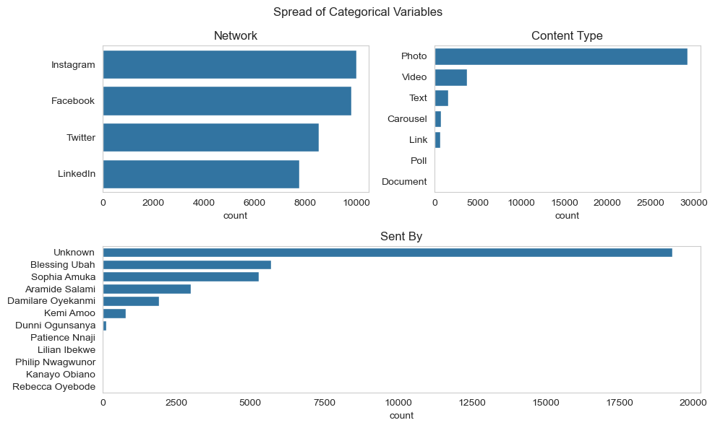
Categorical Features
There are 3 categorical variables: Network, Content Type & Sent by.
From Network, Instagram has the highest number of records in the dataset and LinkedIn has the least.
From Content Type, Photo is the feature with the most number of records and Document is the feature with the least.
Most posts are sent by an unknown sender, but from known senders, Blessing Ubah has the highest number of posts.
Please see the jupyter notebook for more information.

Slide 20
Categorical Features - Network
The 3 main engagement metrics are Impressions, Reach & Engagements.
Impressions is the total number of times a piece of content is displayed on a user's screen.
Reach refers to the unique number of users who have seen a piece of content at least once during a specific reporting.
Engagements encompass various types of interactions that users have with a piece of social media content.
Please see the jupyter notebook for more information.

Slide 21
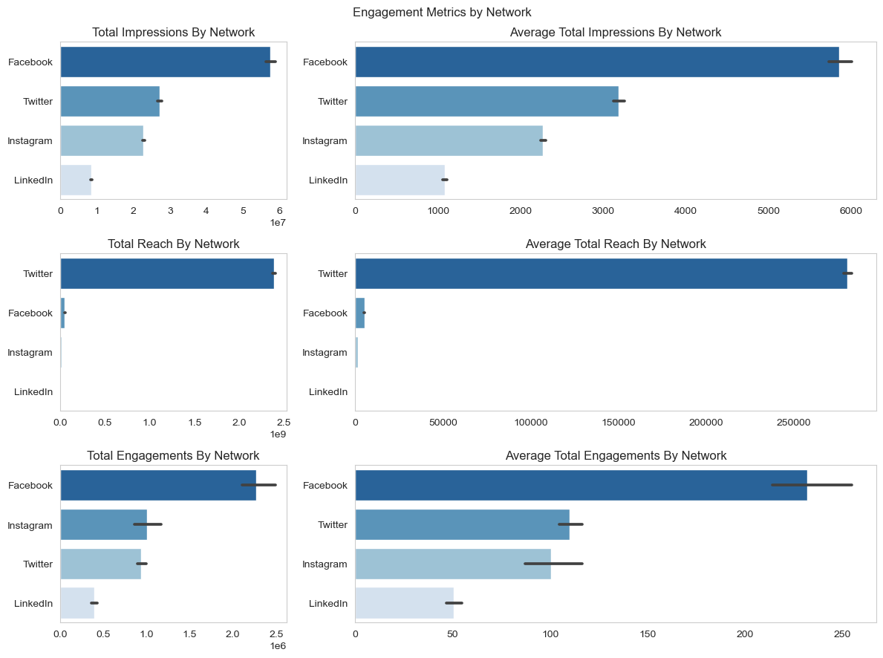
Categorical Features - Network
Facebook is the network with the highest number of impressions, nearly twice the number of the second highest, Twitter
Twitter has the highest Reach. This is likely because Twitter track Reach as Potential Reach, which is likely wider than actual reach.
LinkedIn does not track Reach or any equivalent metric.
Facebook has the highest number of engagements.
Please see the jupyter notebook for more information.

Slide 22
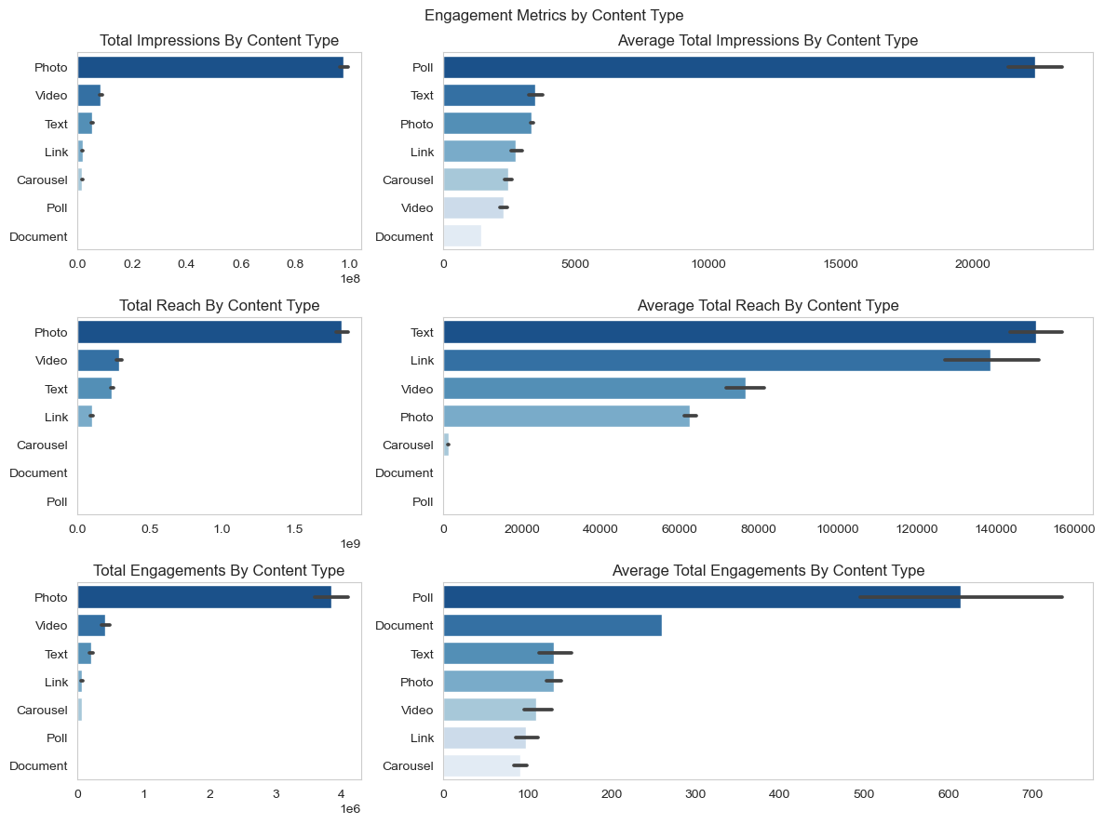
Categorical Features – Content Type
Photo posts have the highest total engagement metrics.
On average, Polls have the highest impressions and engagements. However, there are only 2 poll records in the dataset.
On average, text posts have the highest reach.
Please see the jupyter notebook for more information.

Slide 23
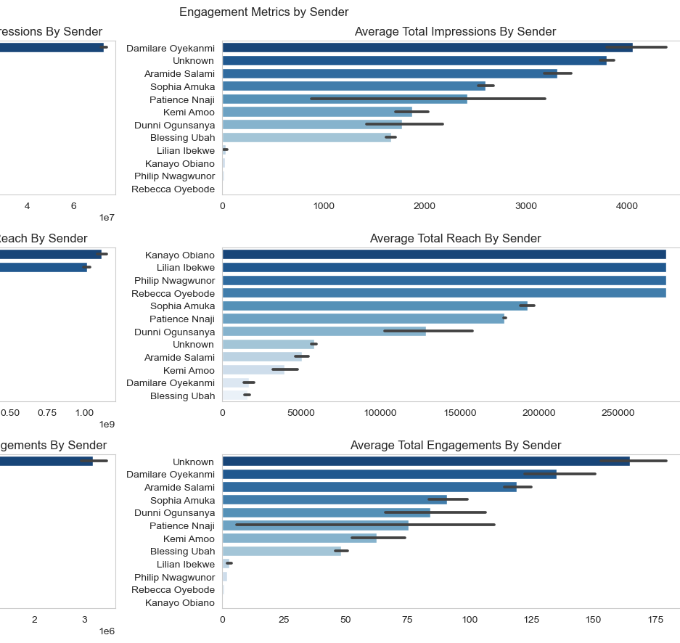
Categorical Features – Sender
The highest total values for all metrics is held by the Unknown poster.
On average, the highest impressions are from posts sent by Damilare Oyekanmi.
The average highest reaches are from posts sent by Kanayo Obiano, Lilian Ibekwe, Philip Nwagwunor and Rebecca Oyebode.
The posts with the highest engagements on average are from the unknown poster, with Damilare Oyekanmi coming in second.
Please see the jupyter notebook for more information.

Slide 24
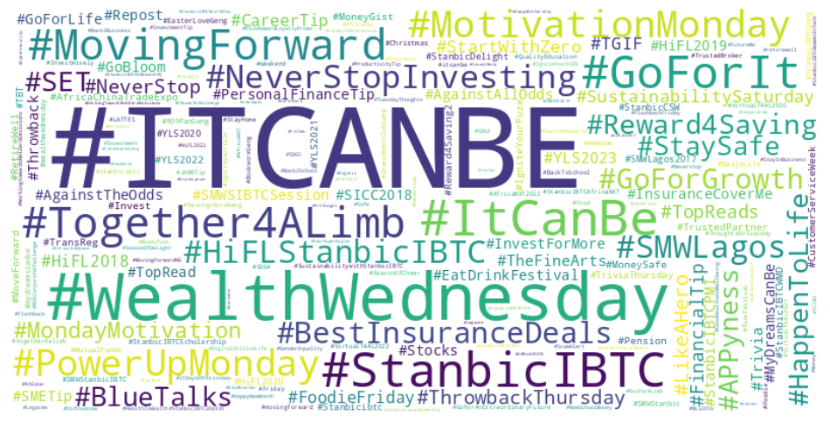
Text-Based Features
There are 4 text-based features: post, linked content, tags and hashtags.
We used hashtags to determine what subjects the posts are talking about.
The most frequent hashtag is #ITCANBE
Please see the jupyter notebook for more information.

Slide 25

Numerical Features – Social Media Metrics
There are 9 types of numeric features / metrics collected in the dataset:
General metrics (collected by at least 3 of the 4 networks)
Impression metrics
Reach Metrics
Engagement Metrics
Reaction metrics
Activity metrics
Click metrics
User-based metrics
Video metrics
Please see the jupyter notebook for more information.

Slide 26
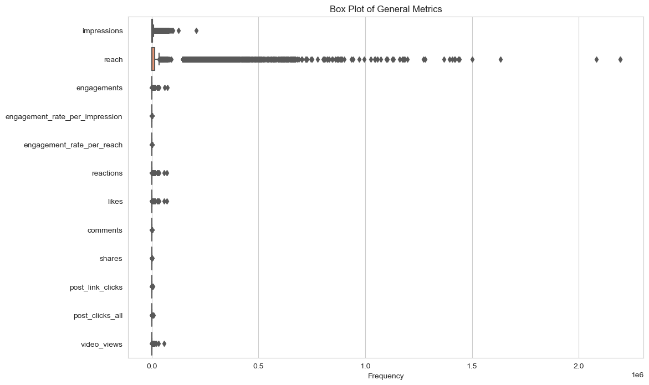
General Metrics
There are 12 general metrics:
Impressions
Reach
Engagements
Engagement rate per impression
Engagement rate per reach
Reactions
Likes
Comments
Shares
Link clicks
All clicks
Video views
This classification will be used for the statistical analysis section.
Please see the jupyter notebook for more information.

Slide 27
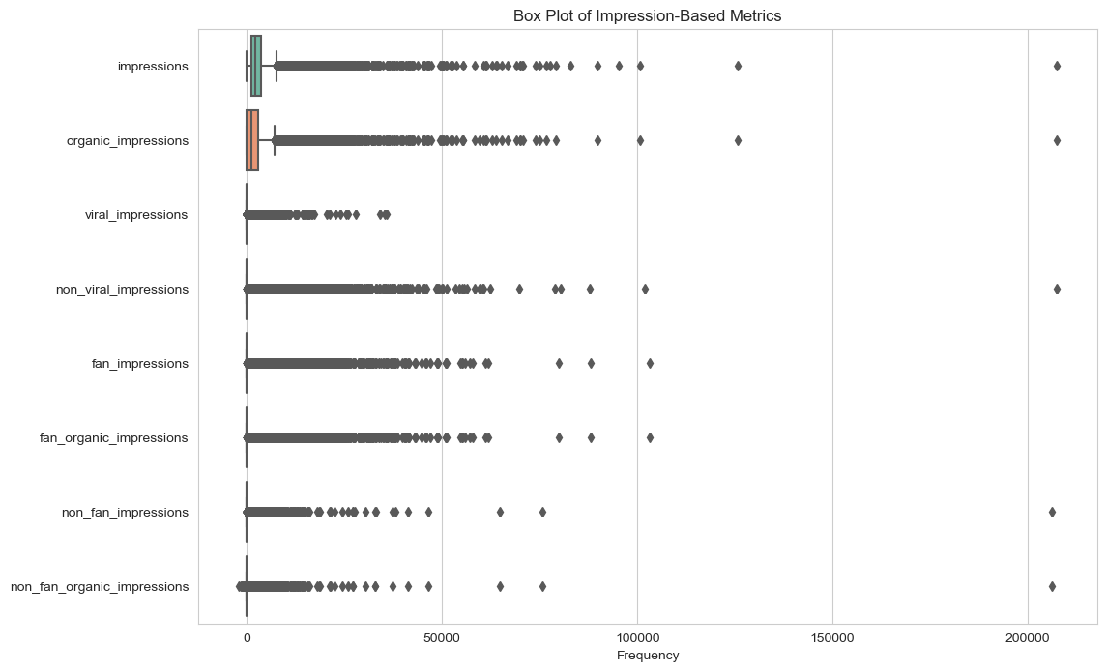
Impression Metrics
There are 8 impression metrics:
Impressions
Organic impressions
Viral impressions
Non-viral impressions
Fan impressions
Fan organic impressions
Non-fan impressions
Non-fan organic impressions
Beyond impressions and organic impressions, other impression metrics are only collected by Facebook.
Please see the jupyter notebook for more information.

Slide 28
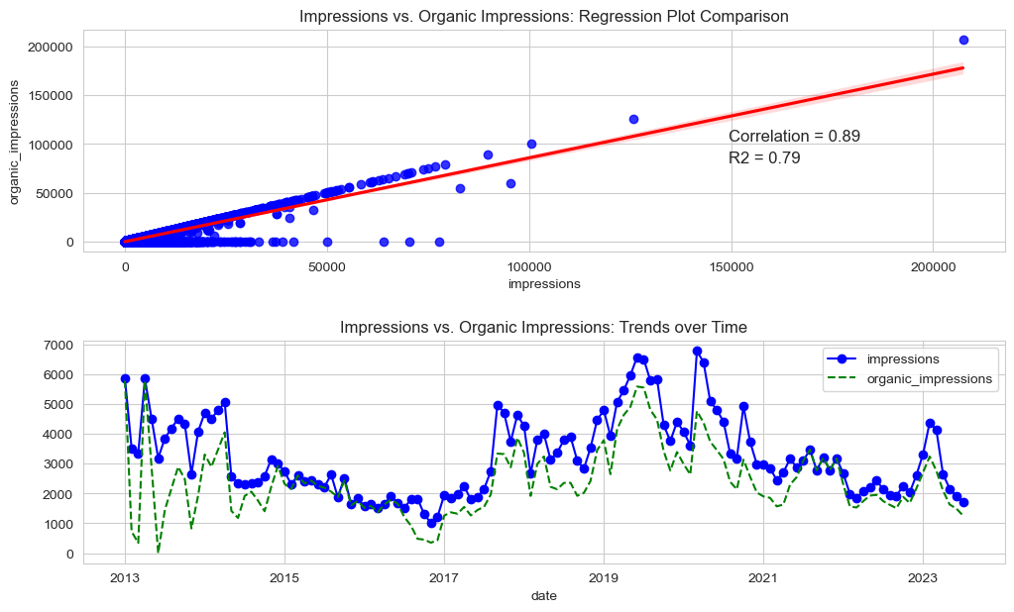
Impression Metrics – Impression vs. Organic Impressions
Organic impressions are impressions generated without any paid promotion or advertising.
Impressions and organic impressions are nearly identical.
This implies that nearly all impressions are organic.
The values on the zero axis represent impressions from Twitter, which does not collect organic impressions data.
Trend data shows that organic impressions are consistently lower than actual impressions, reflecting missing data from Twitter. However, the trend is identical.
Please see the jupyter notebook for more information.

Slide 29
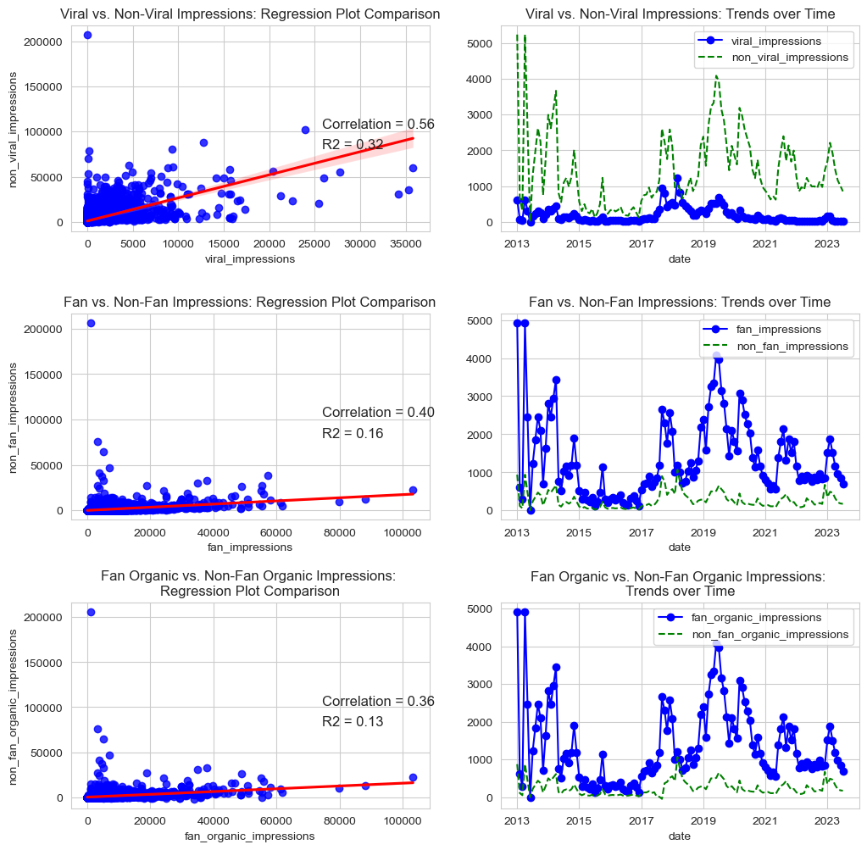
Impression Metrics – Other Impressions
Fan impressions are from users who have liked or followed a Facebook Page (fans) and and non-fan impressions are from those who have not (non-fans).
Viral impressions are from content that spread rapidly and widely across Facebook. Non-viral impressions are those from the limited audience of the poster’s fan or followership.
From the regression plots, there is some correlation between each metric and its opposite.
The trend charts show that a significant amount of the poster’s impressions are from its fans and followers.
Please see the jupyter notebook for more information.

Slide 30
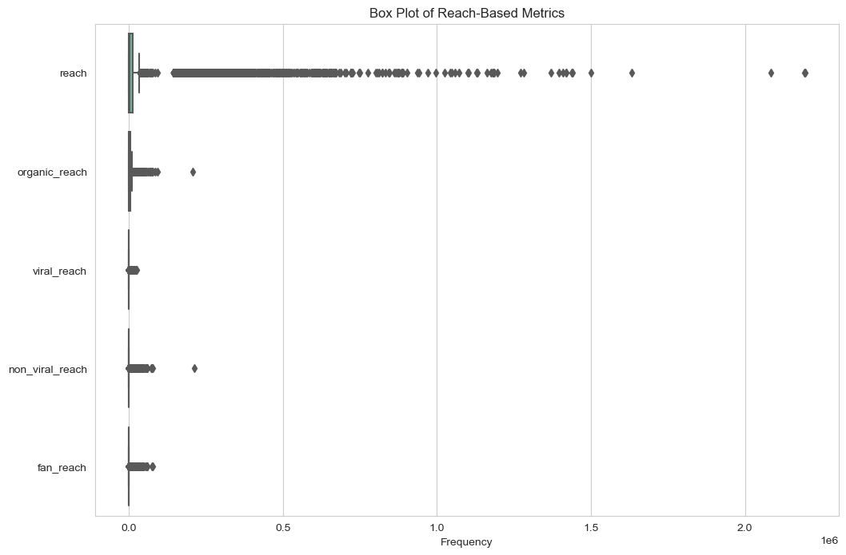
Reach Metrics
There are 5 reach metrics:
Reach
Organic reach
Viral reach
Non-viral reach
Fan reach
Beyond reach and organic reach, other reach metrics are only collected by Facebook.
Please see the jupyter notebook for more information.

Slide 31
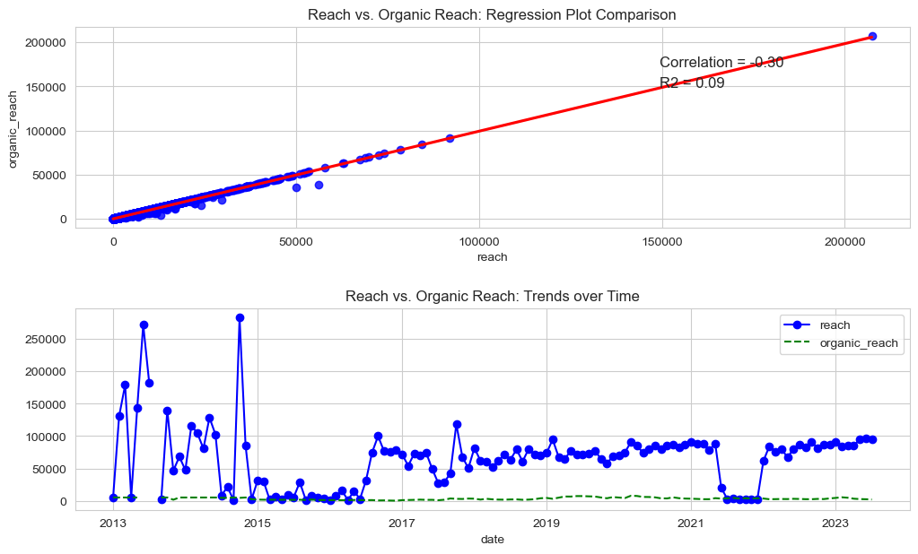
Reach Metrics – Reach vs. Organic Reach
Organic reach refers to the number of unique users who have seen a piece of content through unpaid means.
Reach and organic reach are nearly identical.
This implies that nearly all reach is organic.
There are no reach nor organic reach data attributable to LinkedIn.
Reach has significantly larger values than organic reach due to the large values from Twitter’s potential reach.
Trend data shows that organic reach is consistently lower than actual reach, reflecting missing data from Twitter.
Please see the jupyter notebook for more information.

Slide 32
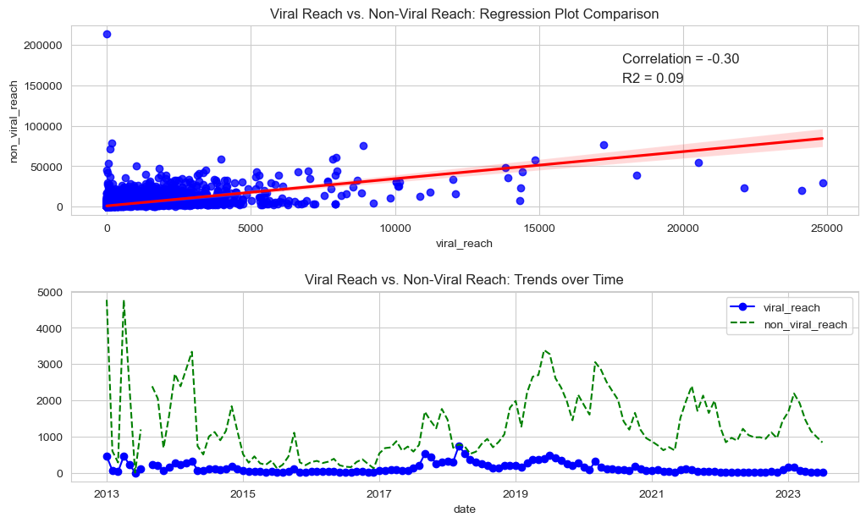
Reach Metrics – Other Reach
Viral reach indicating that a piece of content has gone viral and reached a wide audience, while non-viral reach pertains to content that has not achieved viral status.
Fan reach occurs when content is seen by users who have already liked or followed a specific Facebook Page (fans).
The trend charts show that a significant amount of the poster’s reach are from its fans and followers.
Please see the jupyter notebook for more information.

Slide 33
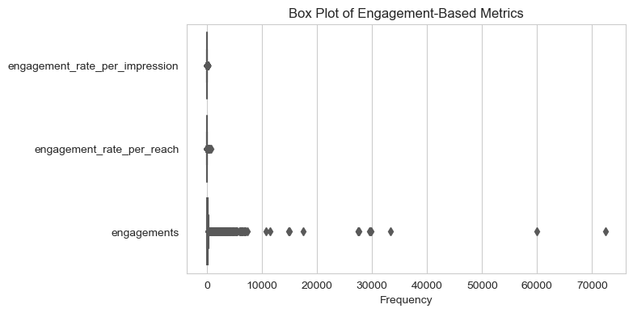
Engagement Metrics
There are 3 engagement metrics:
Engagements
Engagement per impression
Engagement per reach
Please see the jupyter notebook for more information.

Slide 34
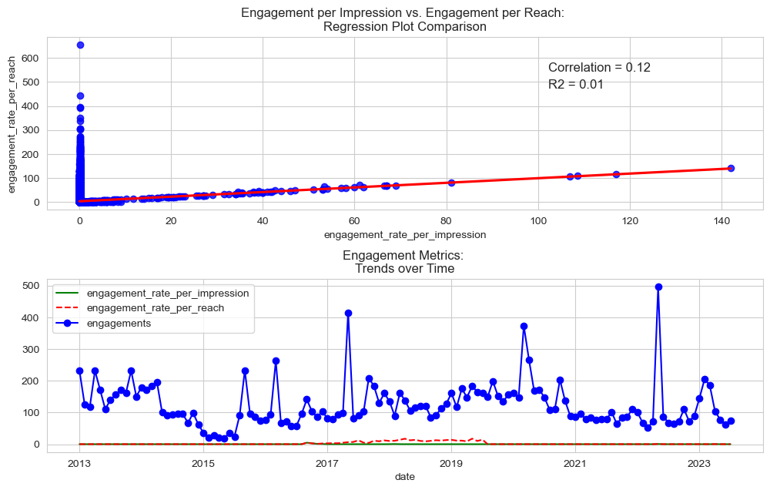
Engagement Metrics
Engagement per impressions and engagement per reach reflect the ratio of engagement and impressions/ reach.
Please see the jupyter notebook for more information.

Slide 35
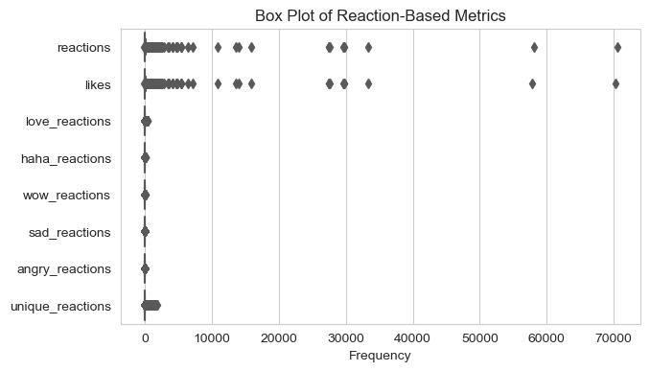
Reaction Metrics
Reaction metrics provide insights into how users are responding to posted content. There are 8 reaction metrics:
Reactions
Likes
Love reactions
Haha reactions
Wow reactions
Sad reactions
Angry reactions
Unique reactions
Beyond reactions and likes, other reaction metrics are only collected by Facebook.
Please see the jupyter notebook for more information.

Slide 36
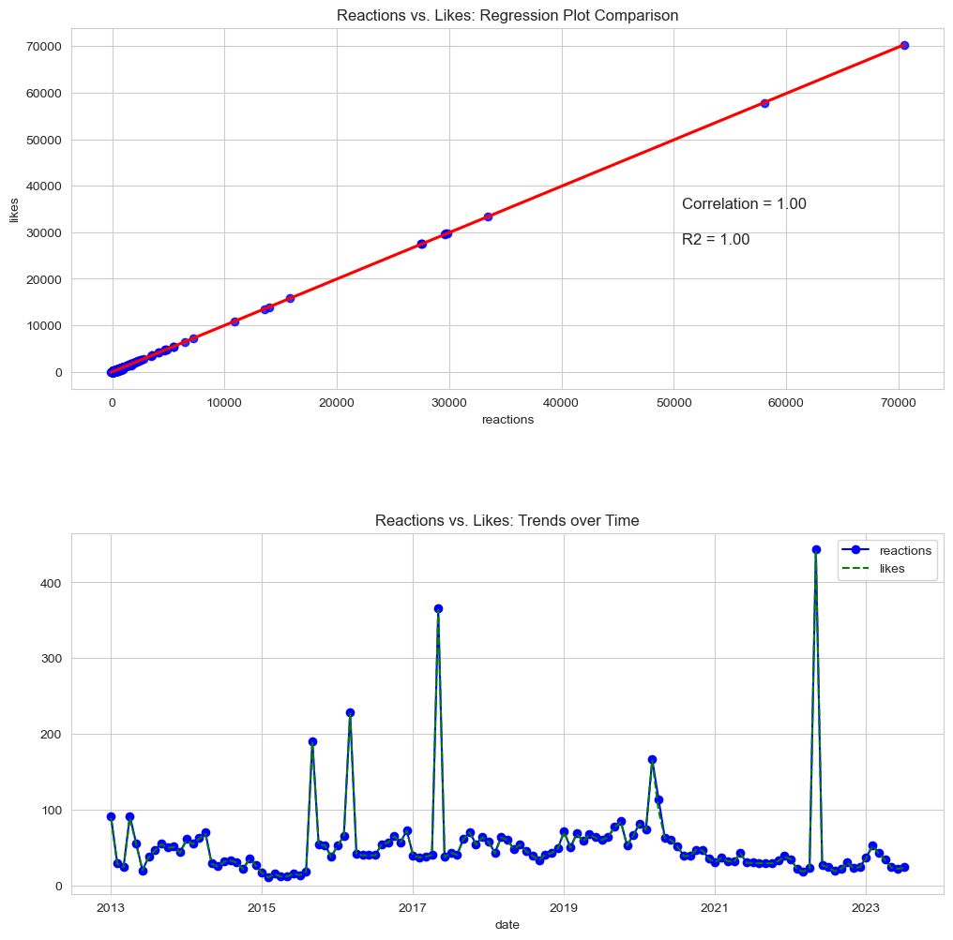
Reaction Metrics – Reactions vs. Likes
Users use likes to express positive reaction to a post. Reactions allow users to express a wider range of engagement a range of emotions in response to content.
In our dataset, reactions and likes are identical.
Please see the jupyter notebook for more information.

Slide 37
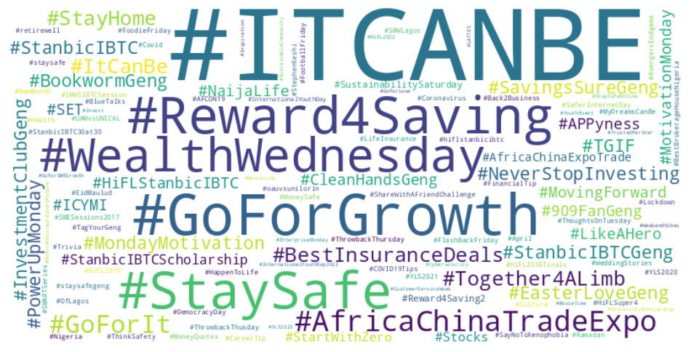
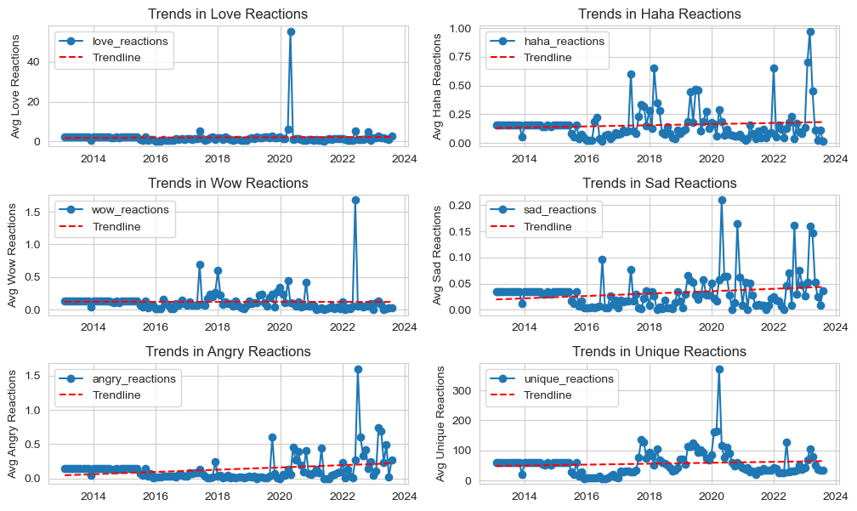
Reaction Metrics – Other Reactions
Apart from love and wow reactions, other reaction metrics have seen an increase in values over time.
Given the relationship between reactions and engagements, this may imply that the poster’s followers have become more engaging.
The highest trend increases are from sad and angry reactions. When compared to the word cloud of hashtags from posts with sad reactions greater than the trendline, the cause of this increase is unclear.
Please see the jupyter notebook for more information.

Slide 38
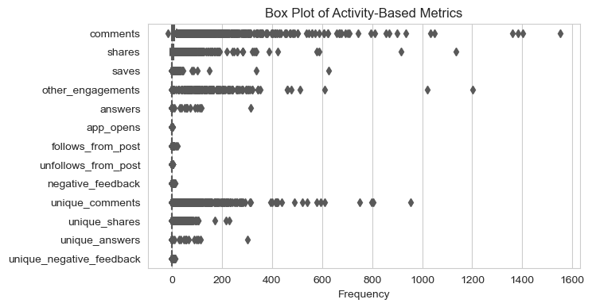
Activity Metrics
There are 13 activity metrics. Comments is the only metric common to all and shares is collected by all but Instagram.
Segmented by network, the activity metrics are:
Facebook – answers, negative feedback, unique comments, unique shares, unique answers, & unique negative feedback.
Twitter – other engagements, app opens, follows from post, & unfollows from post.
Instagram – saves.
Please see the jupyter notebook for more information.

Slide 39
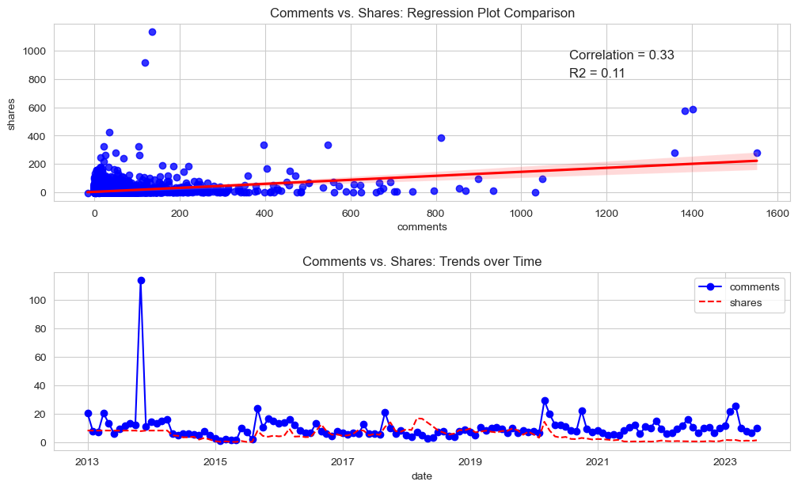
Activity Metrics – Comments & Shares
Comments & shares are slightly correlated. The extension along the 0-axis may represent values from Instagram which does not collect shares data.
The trend of comments and shares are similar, however posts on average have more comments than shares.
Please see the jupyter notebook for more information.

Slide 40
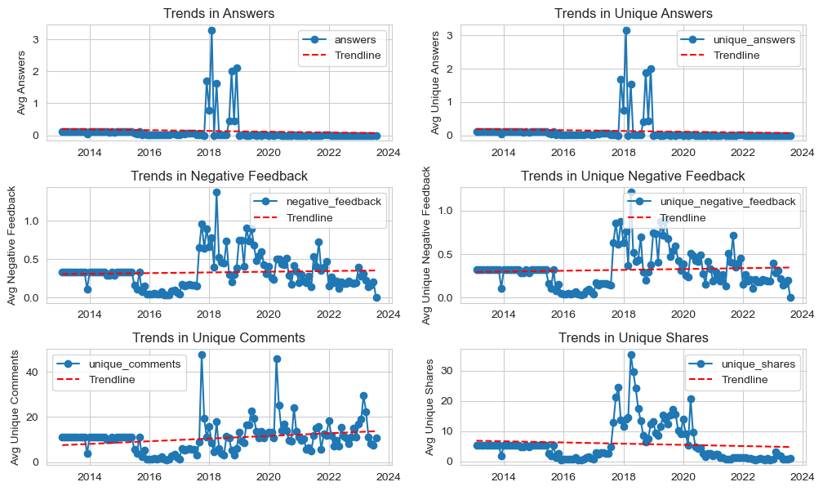
Activity Metrics – Facebook
Trend in answers is on a decline while trends in negative feedback is on the rise.
Unique comments are also rising while unique shares are declining.
While we can’t determine the cause of this from hashtags, senders or content types, we can see from all charts that there is a significant increase in metric values from 2018 that starts to fall around 2020-2021.
This may be the result of changing algorithms and user patterns.
Please see the jupyter notebook for more information.

Slide 41
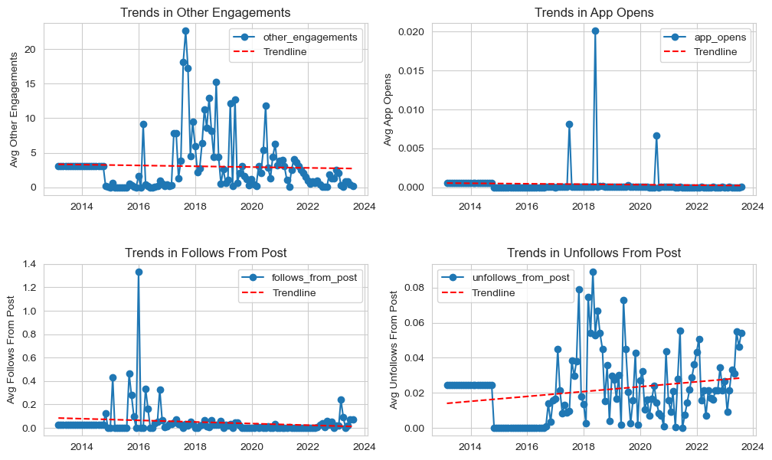
Activity Metrics – Twitter
Trends from all twitter activity metrics are on the decline except unfollows from post which is on the incline.
This is likely due to changing user behaviour on the platform.
While we can’t determine the cause of this from hashtags, senders or content types, we can see from all charts that there is a significant increase in metric values from 2018 that starts to fall around 2020-2021.
This may be the result of changing algorithms and user patterns.
Please see the jupyter notebook for more information.

Slide 42
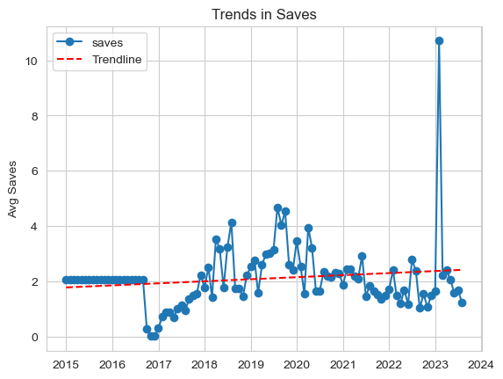
Activity Metrics – Instagram
Instagram saves are on the increase on the average despite a decline from the upward trend peak in 2019.
Please see the jupyter notebook for more information.

Slide 43
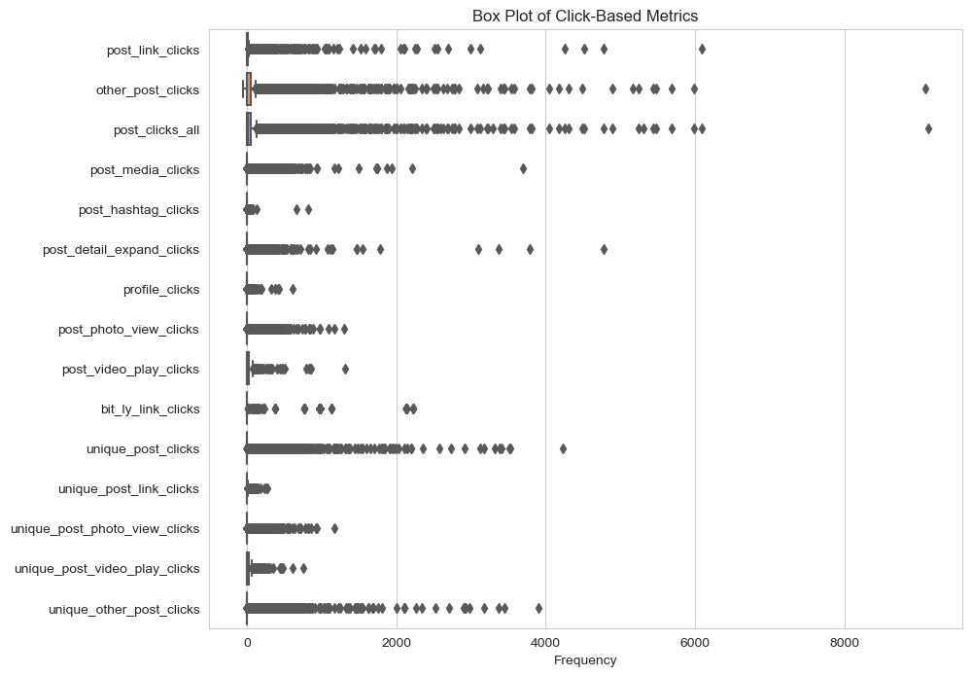
Click Metrics
There are 15 click metrics. Instagram does not collect any click metrics. Of the remaining network, link clicks and all clicks are tracked by all of them.
Segmented by network, the click metrics are:
Facebook – other post clicks, post photo view clicks, post video play clicks, unique post clicks, unique post link clicks, unique post photo view clicks, unique post video play clicks & unique other post clicks.
Twitter – other post clicks, post media clicks, post hashtag clicks, post detail expand clicks, profile clicks & bit.ly link clicks.
Please see the jupyter notebook for more information.

Slide 44
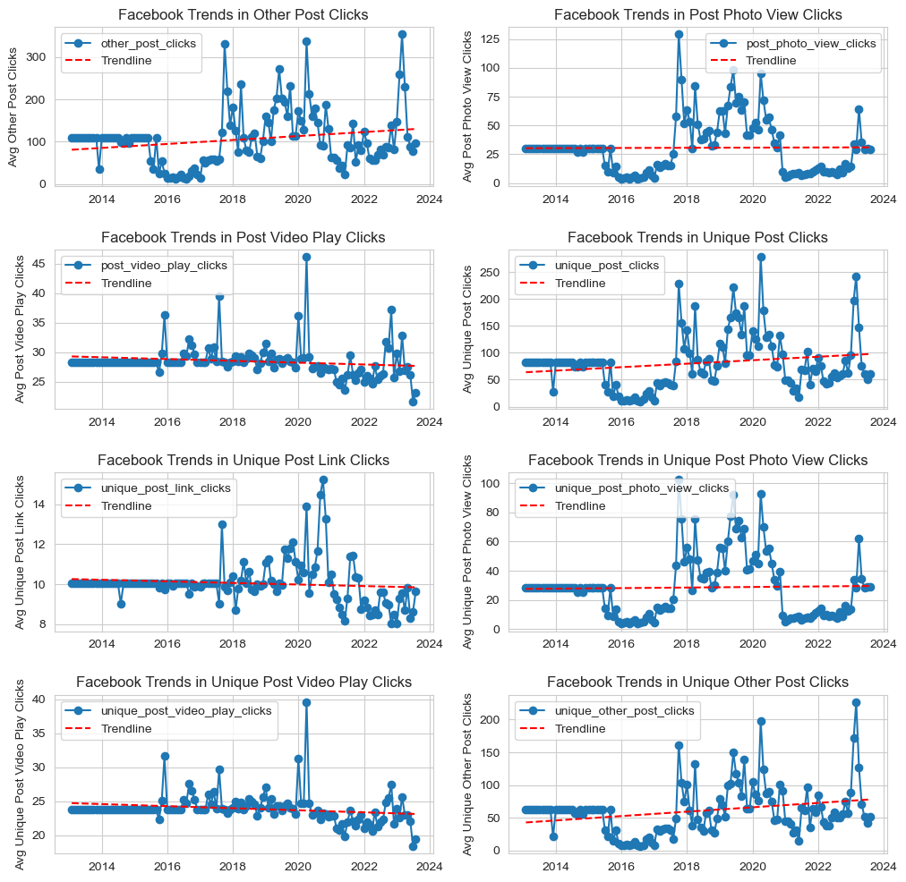
Click Metrics – Facebook
The trend for clicks on posts (possibly to read more) is on the rise, but the trend for link and video post clicks are on the decline.
This may be because the poster’s Facebook fans either prefer text posts to video / link posts and/ or text posts are cheaper on user data than other posts.
The poster must have a posting strategy for each social media network that includes how its user base engages with the platform.
Please see the jupyter notebook for more information.

Slide 45
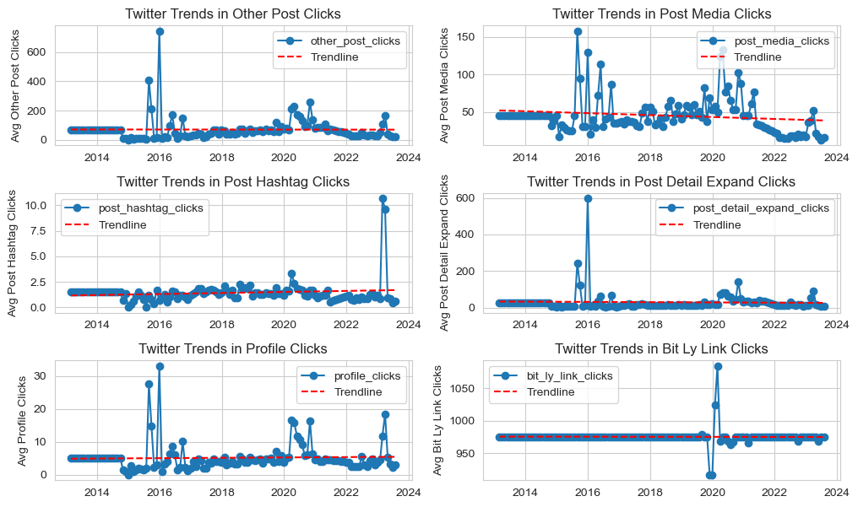
Click Metrics – Twitter
Most twitter click trends are flat.
Media clicks trend is on the decline, facing a sharp decline from 2021.
Hashtag clicks is trending slightly upward, which is line with how users use Twitter.
Please see the jupyter notebook for more information.

Slide 46
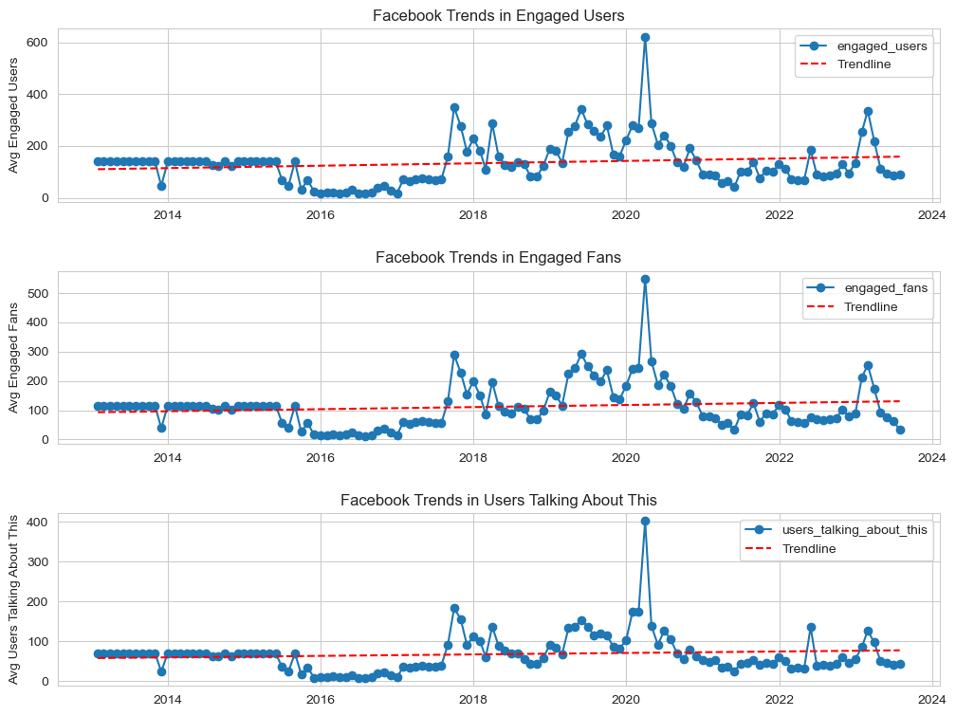
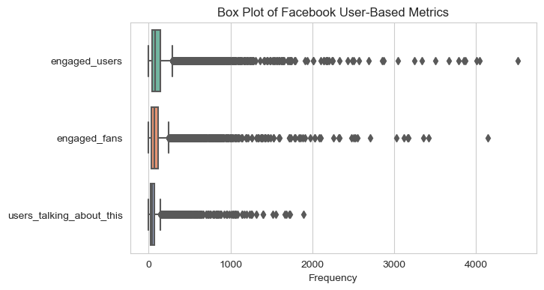
User-Based Metrics
User based metrics are only tracked by Facebook.
All these metrics are on an upward trajectory, implying that the poster’s followers are increasingly engaging with the content on its page.
Across all metrics, there is a significant spike in values between 2018 and 2020. This reflects a trend across many other metrics.

Slide 47
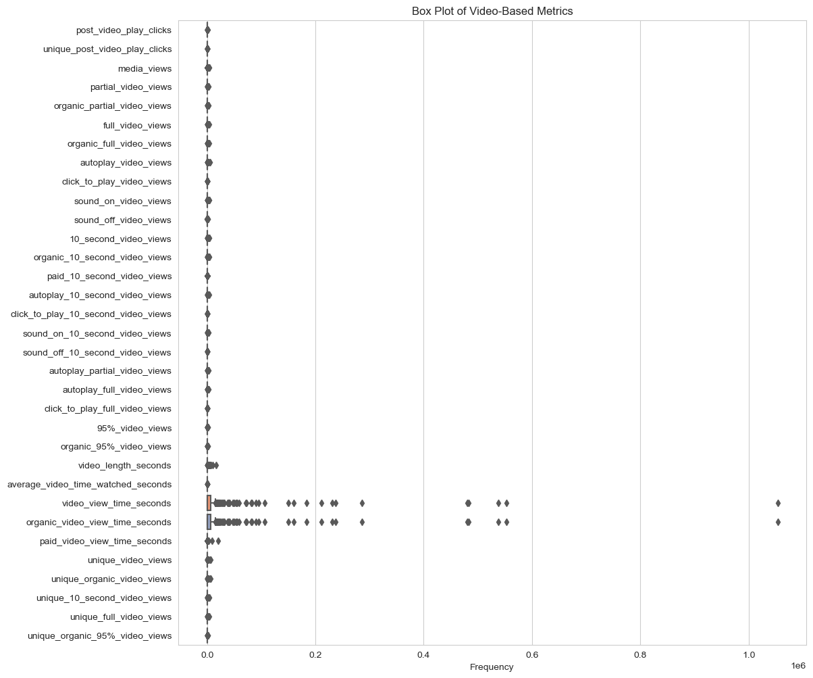
There are 32 video metrics all of which are tracked by Facebook except media views, which is only tracked by Twitter.
Video Metrics

Slide 48
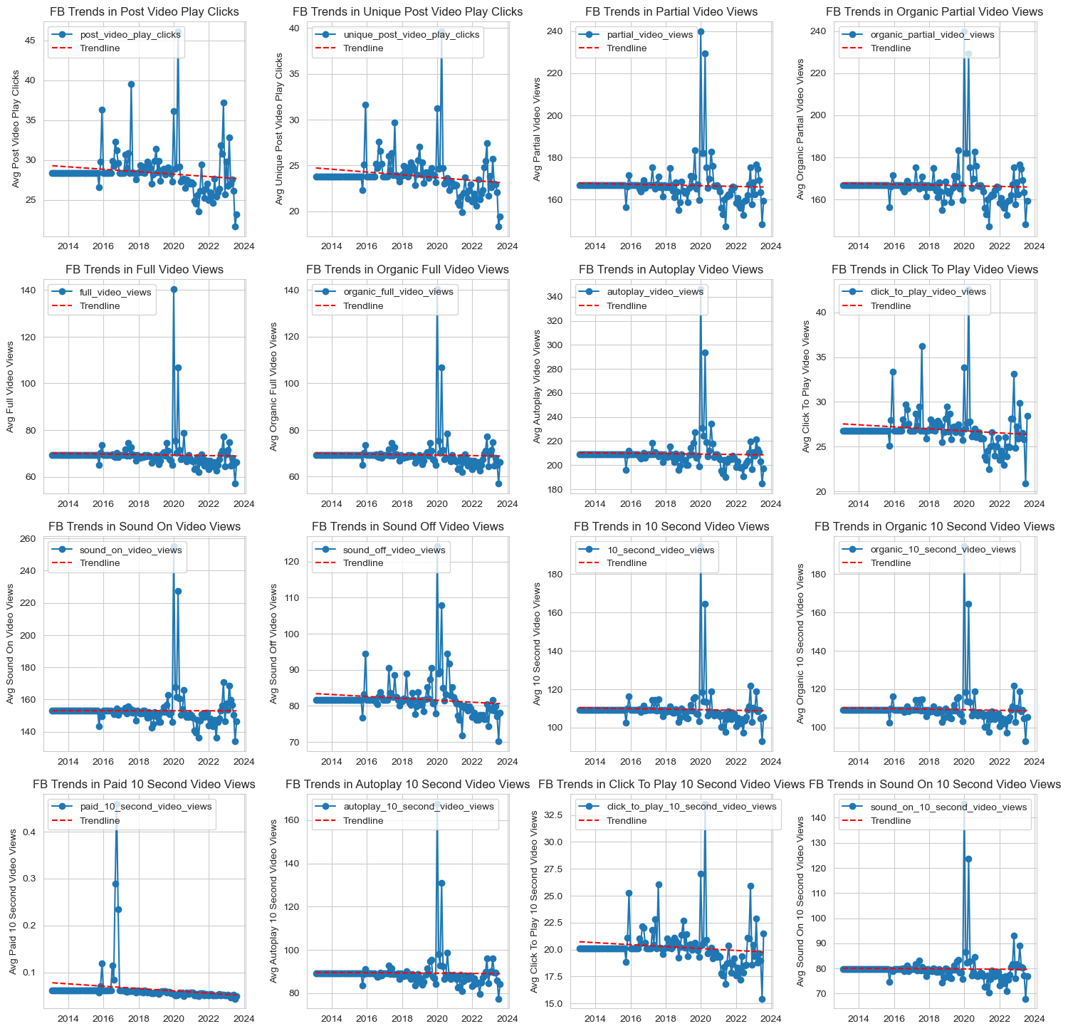
Video Metrics – Facebook
All Facebook video metrics are either flat or trending downward.
This confirms the trend we saw in clicks about video which has seen a sharp decline.
Please see the jupyter notebook for more information.

Slide 49
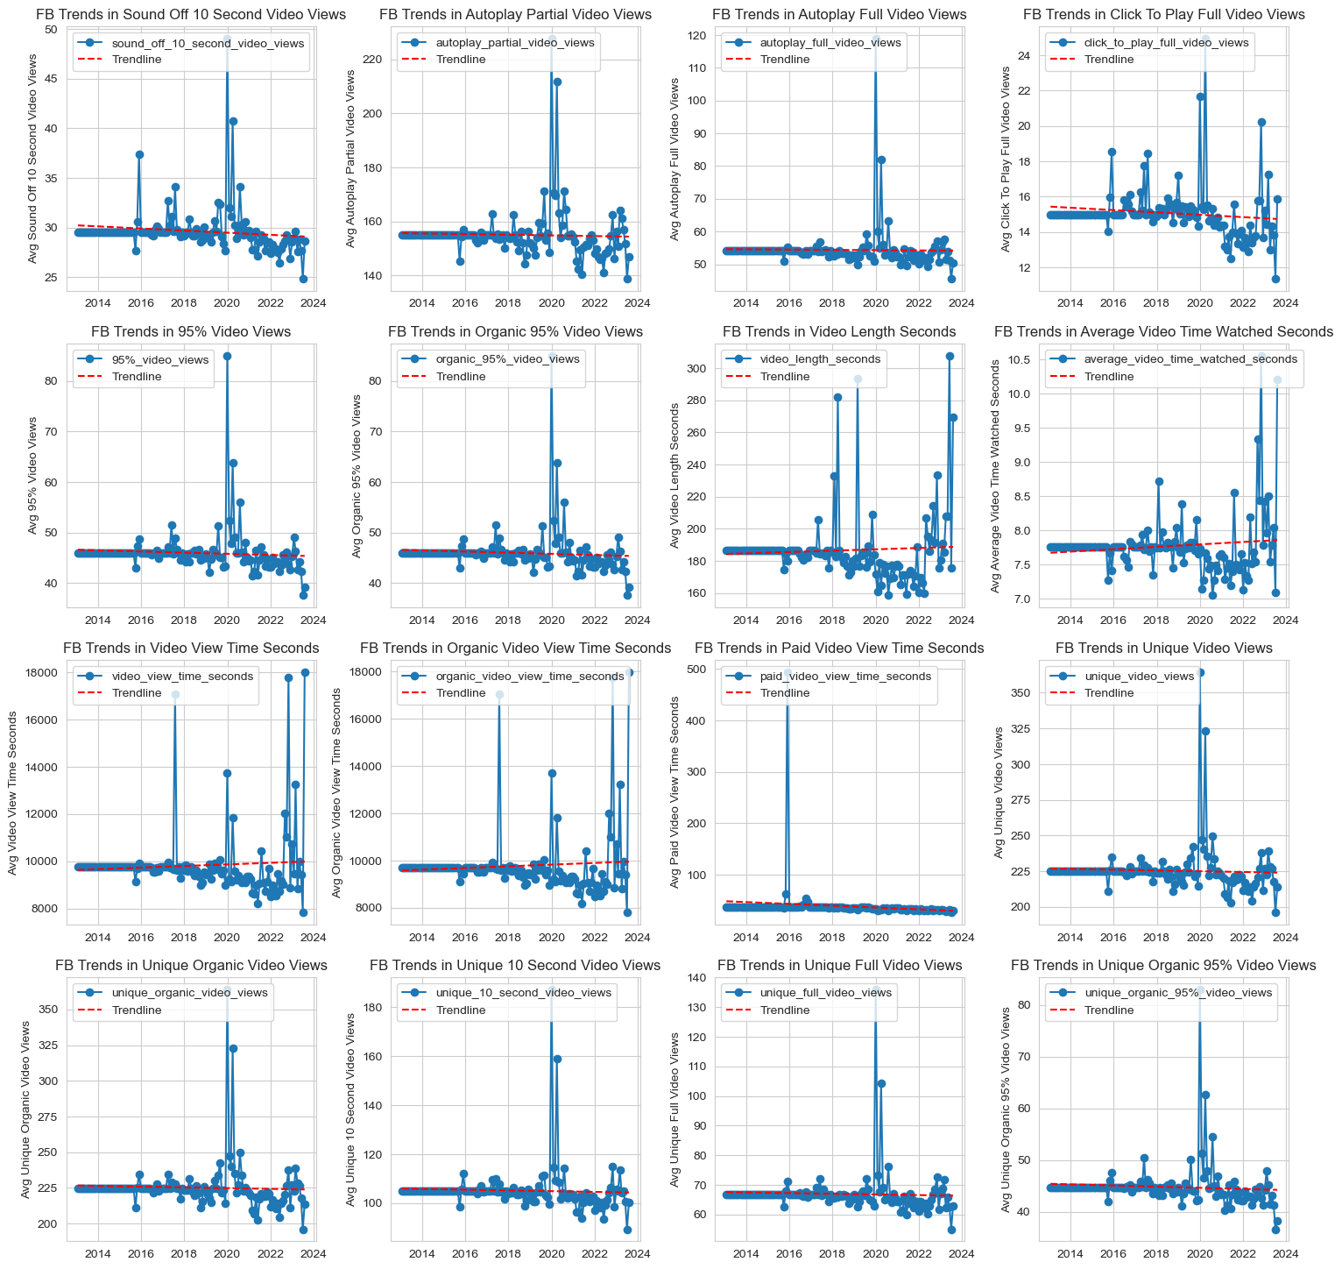
Video Metrics – Facebook 2
All Facebook video metrics are either flat or trending downward.
This confirms the trend we saw in clicks about video which has seen a sharp decline.
Please see the jupyter notebook for more information.

Slide 50
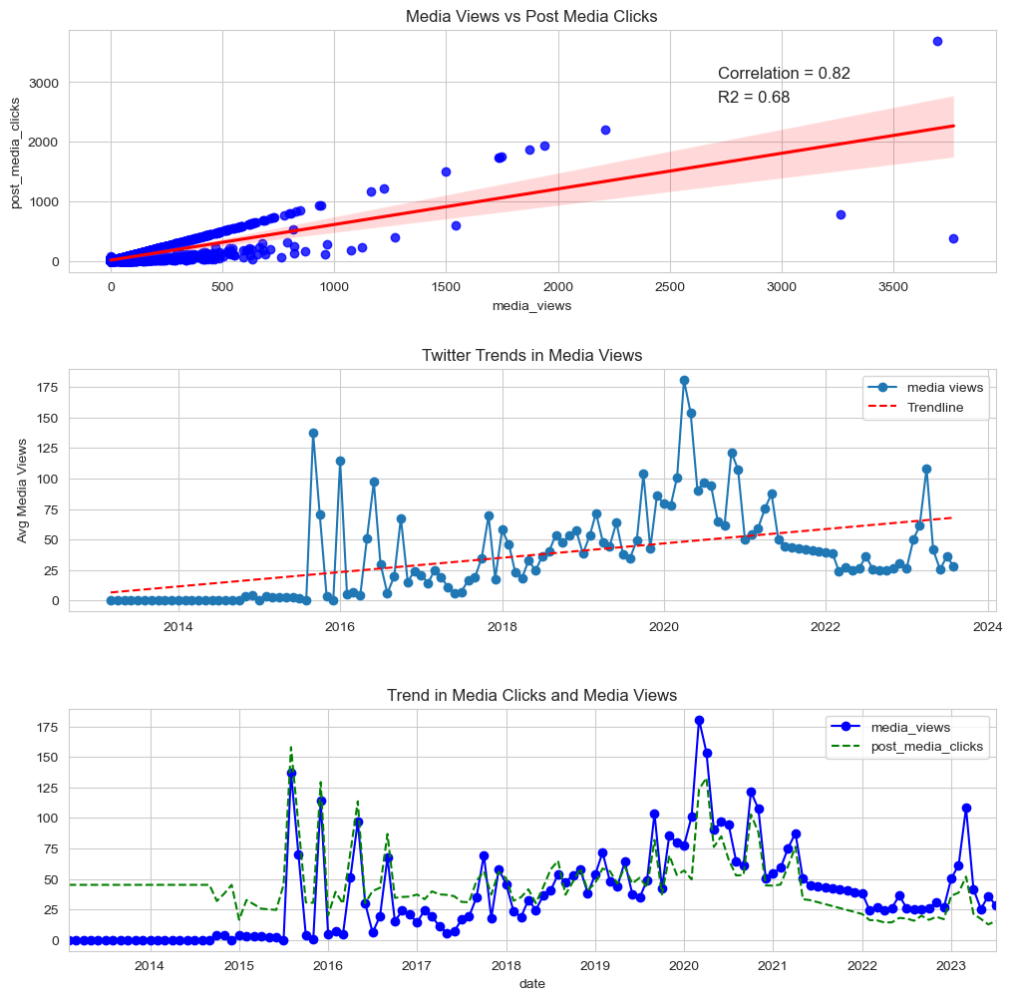
Video Metrics – Twitter
Twitter media view trends are on the upward incline. This is contrasted with post media clicks which are on the decline.
Media clicks and media views are positively correlated yet move in negative direction over time.
The trendlines for both metrics are similar but there is a slight downtrend in media clicks trend.
Please see the jupyter notebook for more information.

Slide 51
Section 3 Key Questions Addressed in Exploratory Analysis

Slide 52
Are Impressions Seasonal?
When grouped by months, Impressions seem to be on an upward trend between November and April (the dry months in Nigeria’s seasonal calendar), with the exception of a dip in February.
The lowest months for impressions are the months between May and November (the wet months in Nigeria’s seasonal calendar), with exception of a peak in July.
This implies that impressions are seasonal.

Slide 53
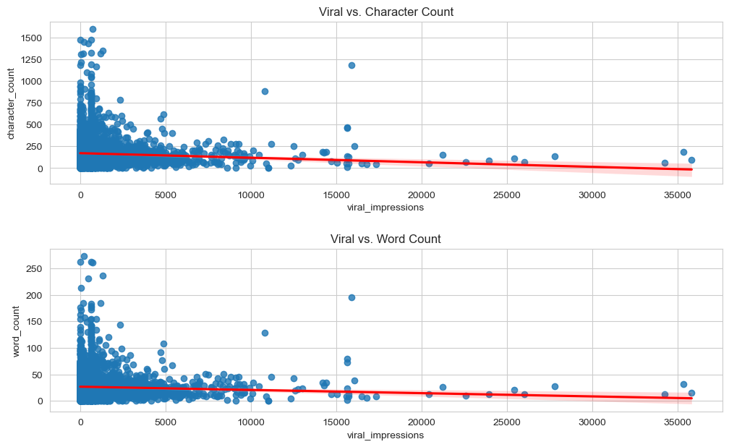
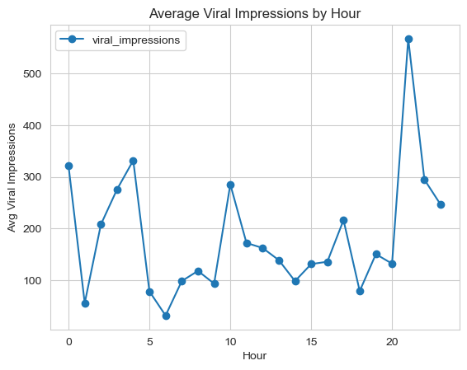
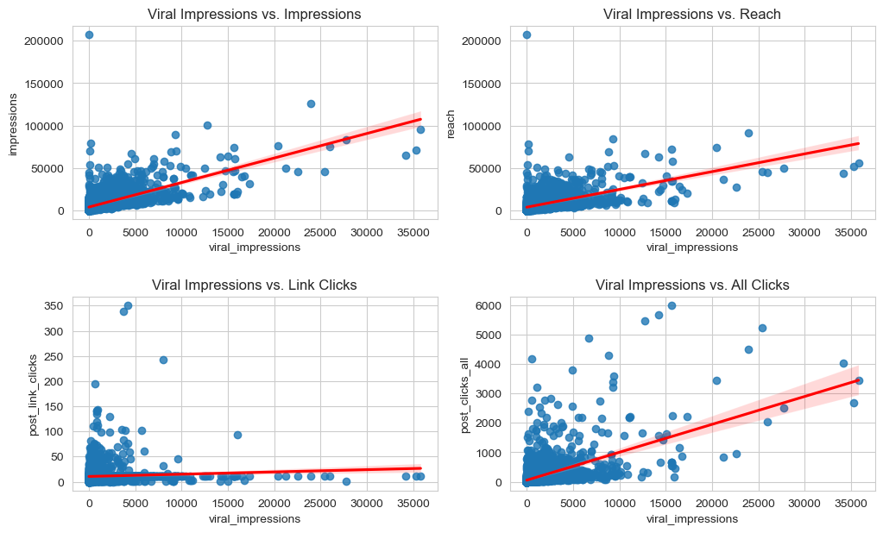
What trends favor virality?
Virality is not strongly correlated with word or character counts.
On average the most viral posts are those made around 9pm.
Impressions, reach and all clicks are positively correlated with virality. However, this does not tell us which variable is dependent on the other.
Expanding impressions, reach and posting interesting content during evening time generally seems to positively favour virality.

Slide 54
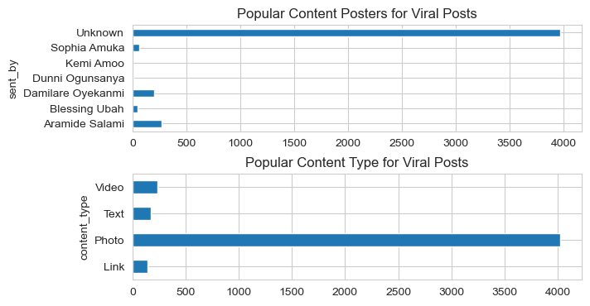
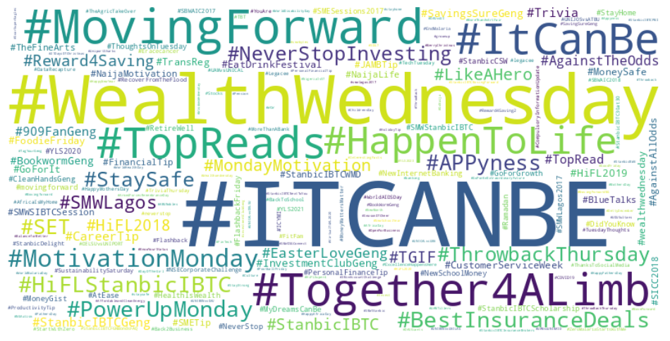
Popular Content Type & Senders for Posts with Above Average Virality
Generally, for posts with viral values in excess of the average, the unknown poster and photo posts are the most popular. This is no different than the general counts for those features.
The word cloud of hashtags for posts with viral values in excess of the average looks no different than the general word cloud for hashtags of the whole dataset.
This means that categorical features may not be correlated with virality.

Slide 55
Section e Insights Drawn From Statistical Analysis

Slide 56
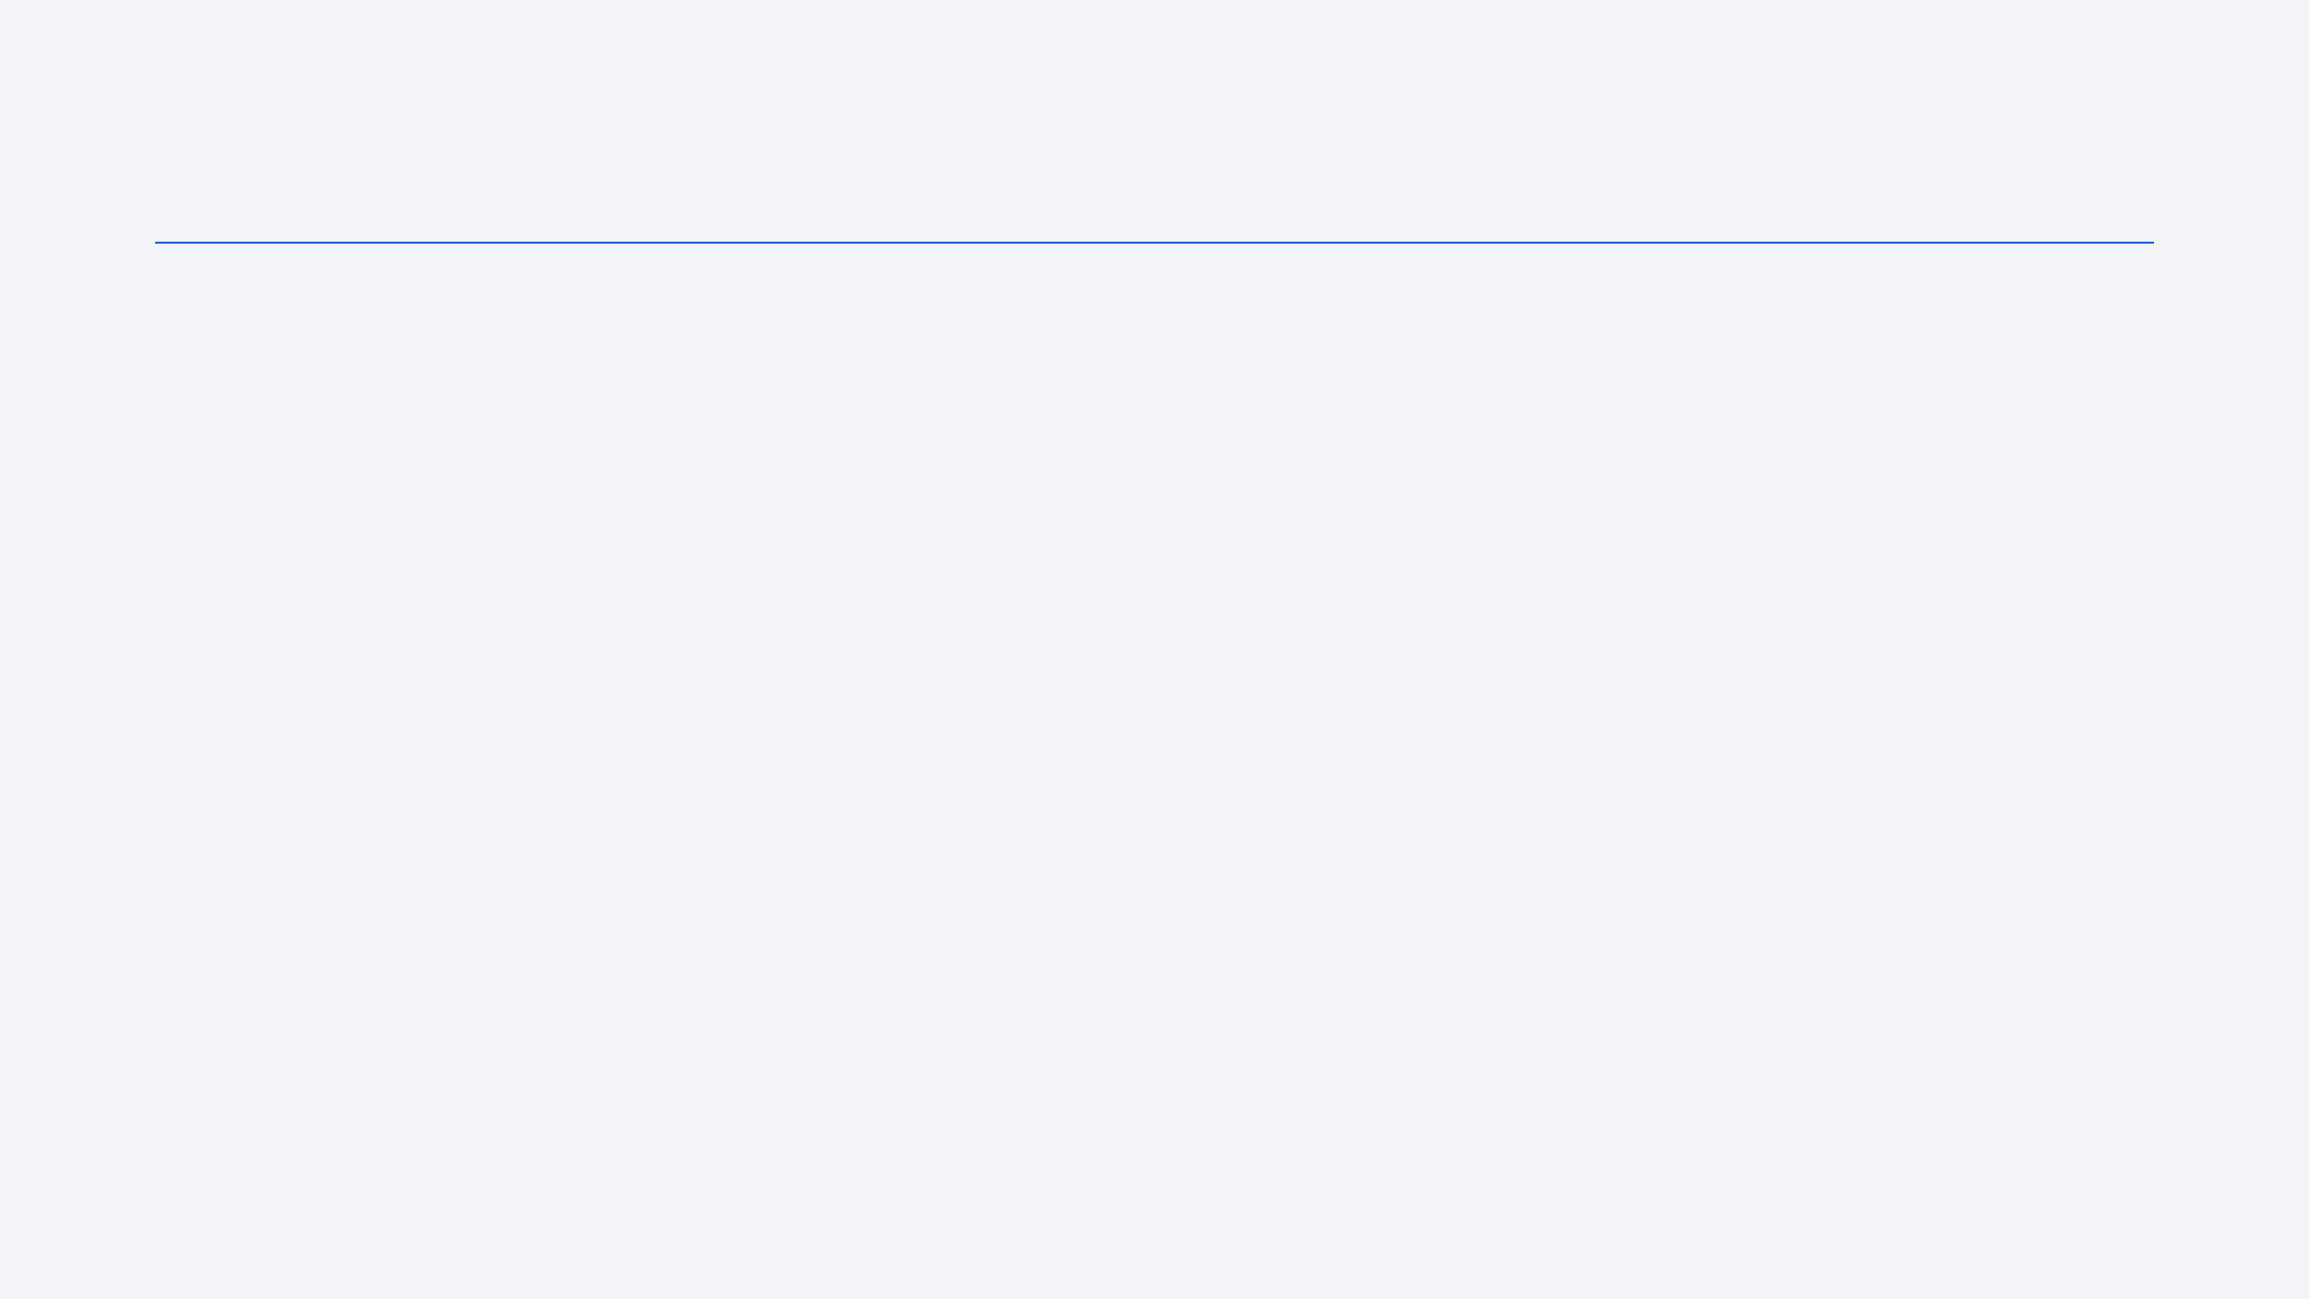
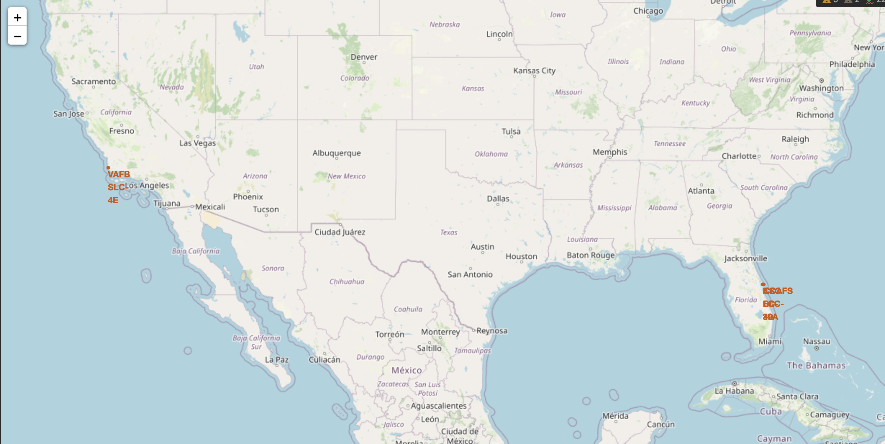
Launch Site Markers on Folium Map
SpaceX launch sites are located on the coast of the United States in Florida and California

Slide 57
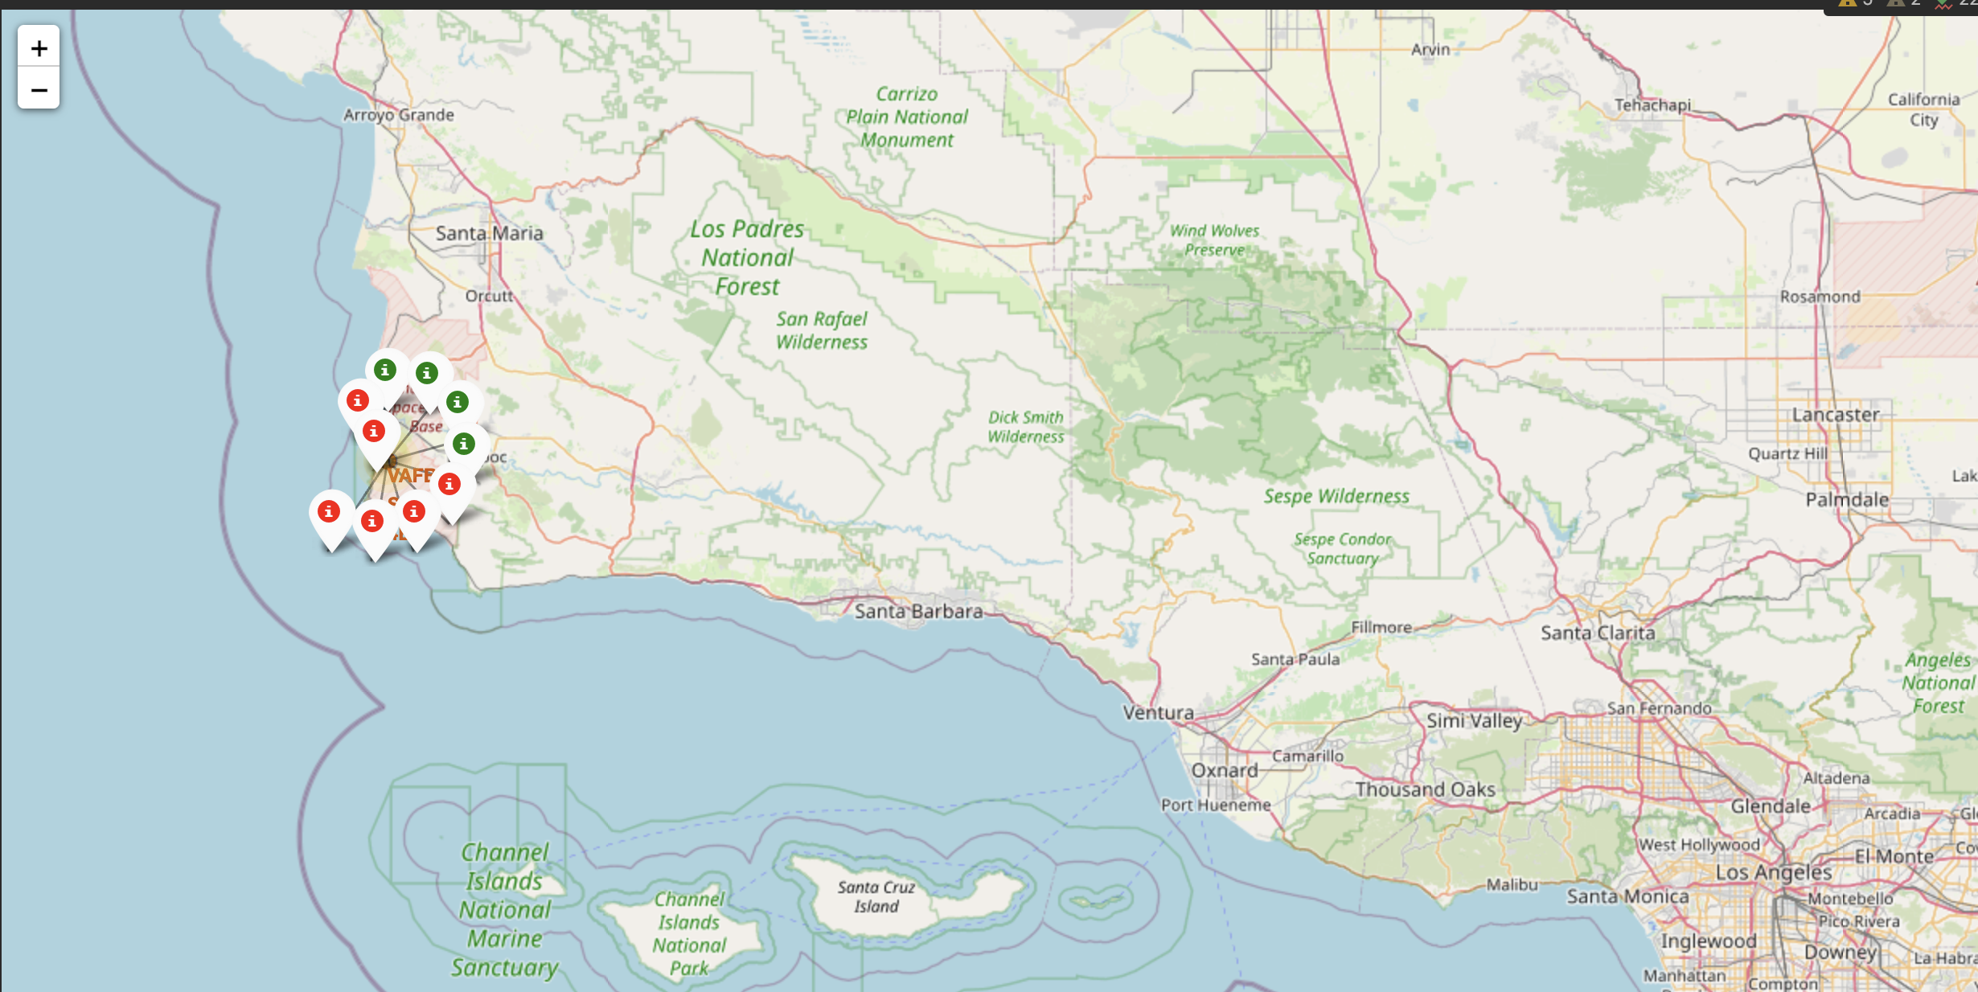
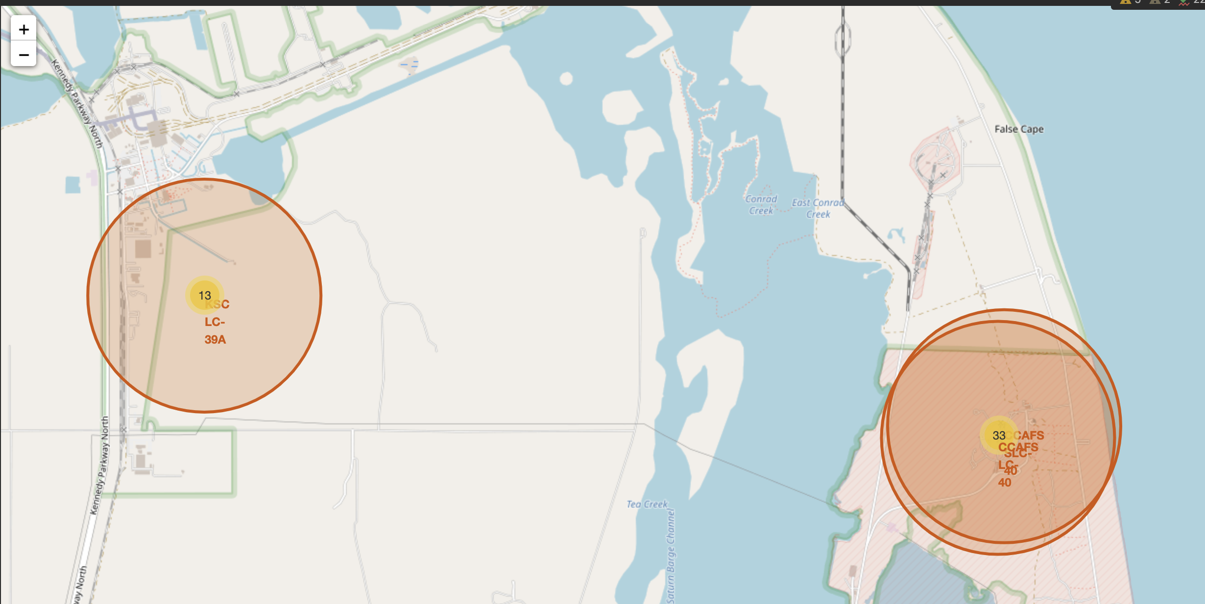
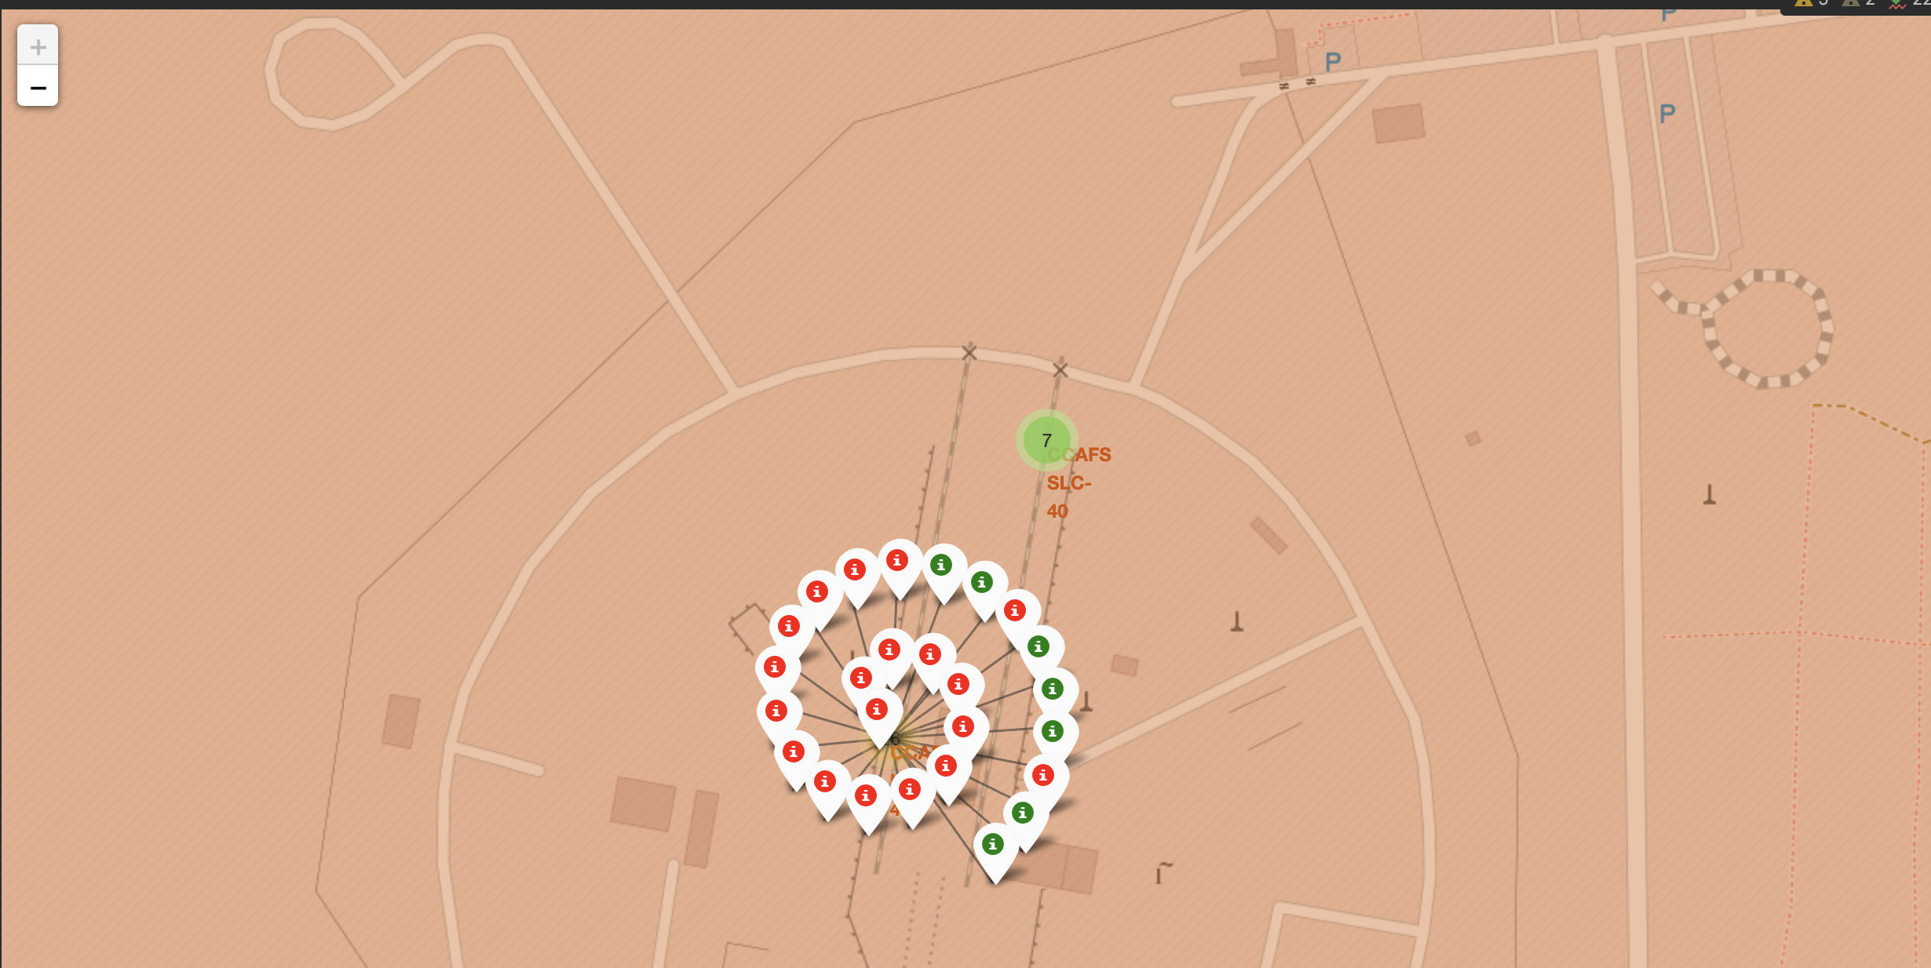
Markers Showing Launch Sites with Color Labels
California Site
Florida Sites
The Markers designate outcomes
Green = Success
Red = Failure

Slide 58
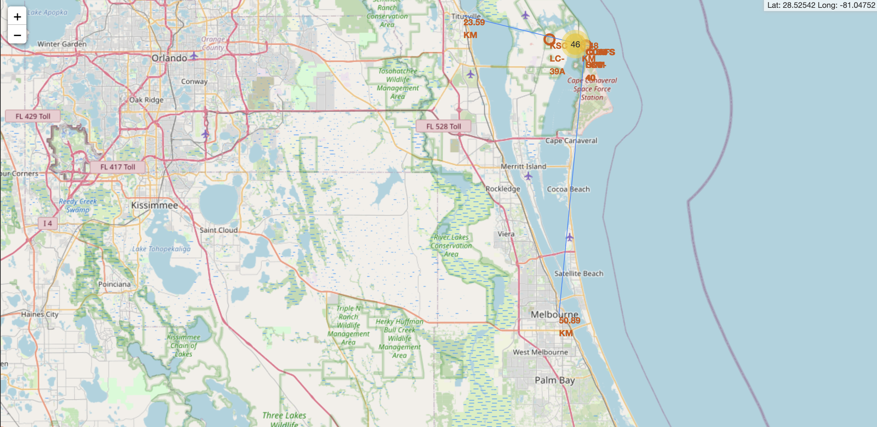


Distance to Landmarks
In siting launch sites, proximity to the coastline is priority. All sites are very near the coast.
The closest coordinate to the CCAFS launch sites is the highway (Samuel C. Phillips Pkwy) (0.66Km). This may reflect transportation needs, especially of persons.
The next closest coordinate is the Atlantic coastline (1.0km). This is possibly because of SpaceX's landing guidelines which prioritize ocean landing.
The third nearest distance is between the launch sites and the nearest railway (1.45km). This may reflect the need for quick and easy transport of supplies.
Finally, each launch site is a considerable distance away from city centers (Titusville - 23.59km and Melbourne - 50.89km). Due to the nature of the work being done, it is important to site launches away from cities and places where the population density is high.

Slide 59

Section 4

Slide 60

Pie chart showing success rate for all Sites
CCAFS LC-40 is the launch site with the most successful launches

Slide 61

Pie chart showing Site with highest success ratio
KSC LC-39A is the launch site with the highest success ratio

Slide 62



Scatterplot showing Payload v. Launch Outcome
We can see success v. failure ratio based on payload range.
The range 5k – 10k has the lowest launch success rate.
The FT booster has the highest success rate and v1.1 has the lowest

Slide 63

Section 5

Slide 64

Classification Accuracy
The best model for the Training Data is Decision Tree with an accuracy score of 0.89
For the test data, all models except Decision Tree have an accuracy of 83%

Slide 65
Confusion Matrix
From the confusion matrix, we can see that the models are biased toward successful outcomes.
Therefore, the model predicts landed when (positive outcomes) for did not land (negative outcomes) but does not predict the inverse case.

Slide 66

Conclusions
The larger the flight amount at a launch site, the greater the success rate at a launch site.
Launch success rate started to increase in 2013 till 2020.
Orbits ES-L1, GEO, HEO, SSO, VLEO had the most success rate.
KSC LC-39A had the most successful launches of any sites.
Depending on whether training or test data is used for accuracy, the Decision Tree model may be the most or least accurate model.

Slide 67


